Slide 1
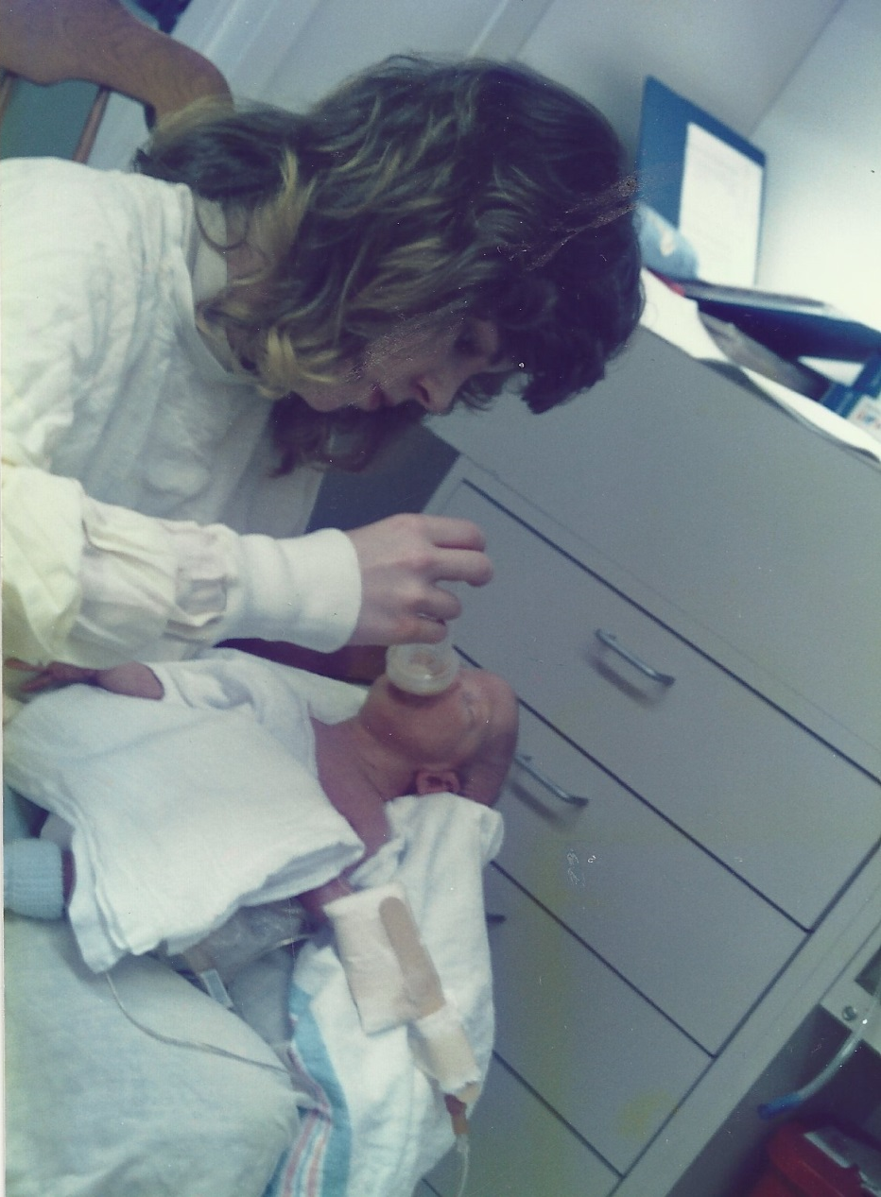
In July of 1989, Noah was born.
He was born very early.
He was very small,
and he was very sick.
Noah had vision
and hearing losses.
He was not able to walk or talk.

Slide 2
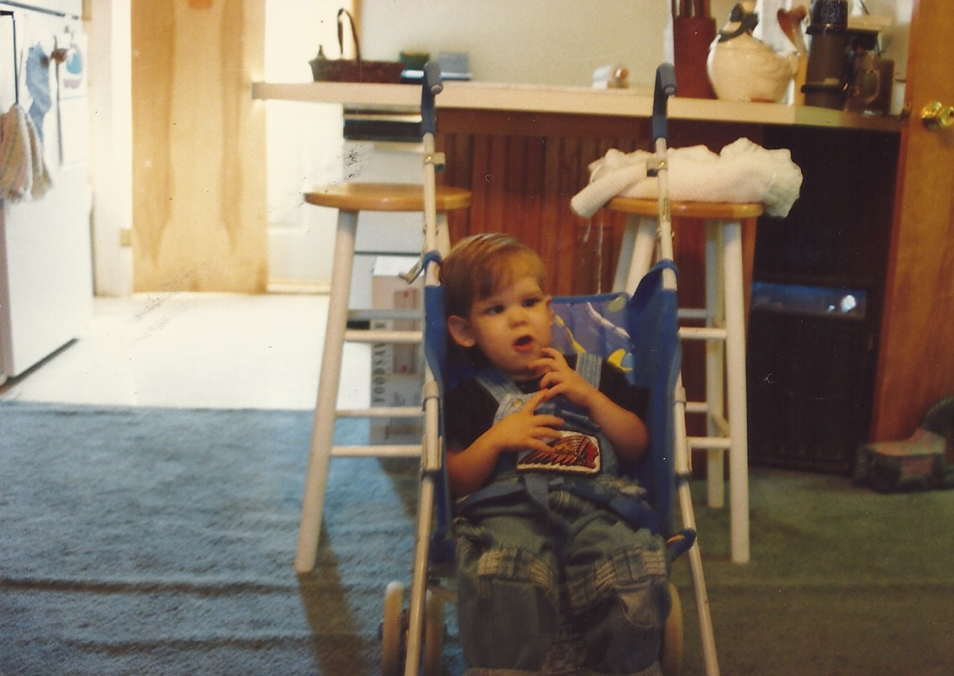
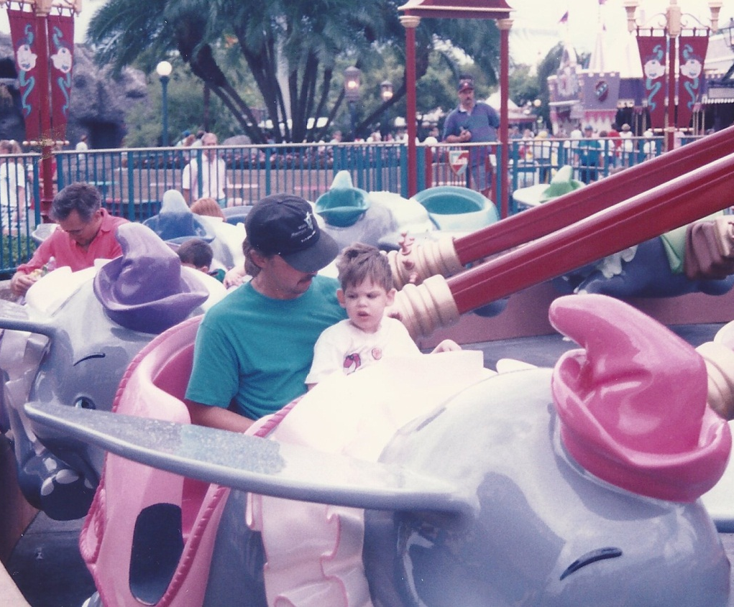
What is that blurry blob?
What was that noise?
What did Noah see?
What could he hear?
What could he understand?

Slide 3
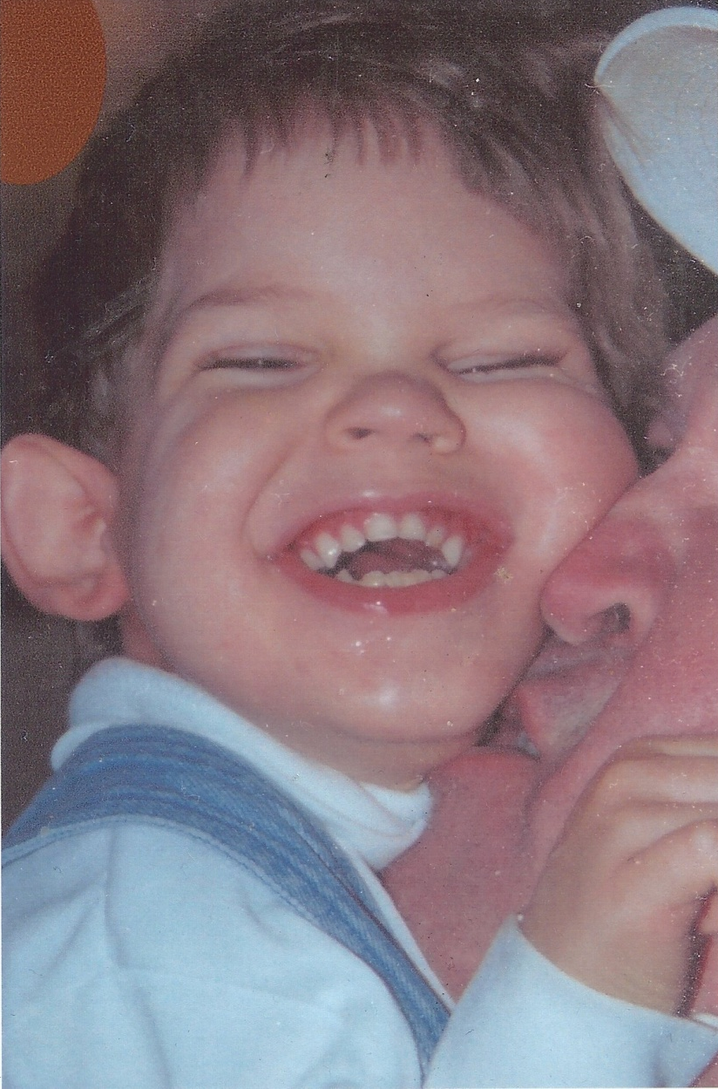

Slide 4
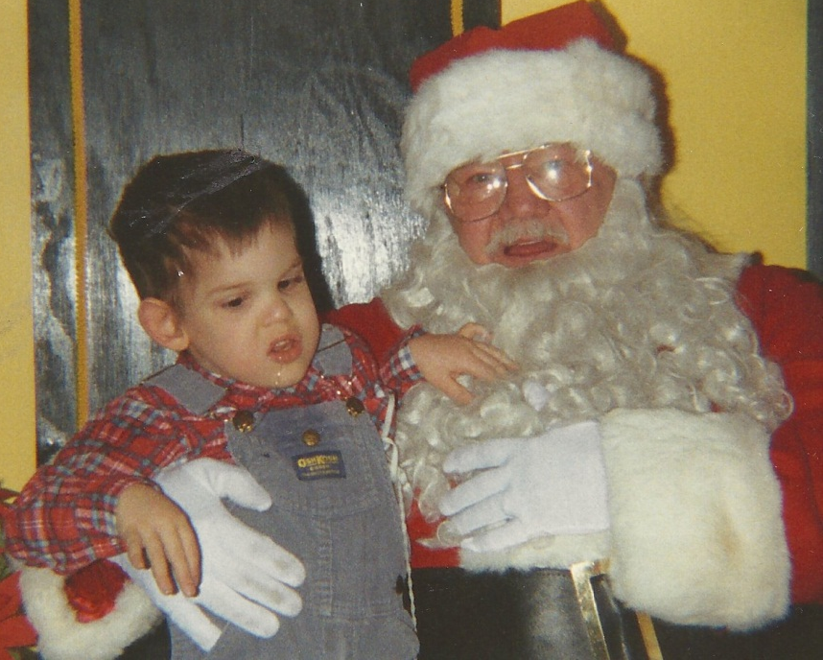

Slide 5
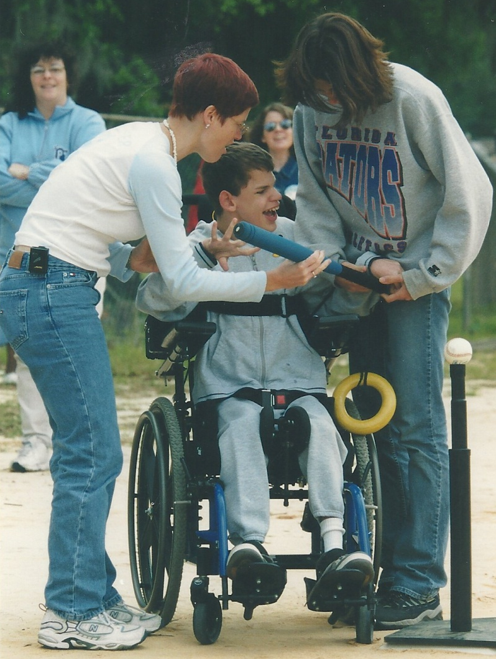

Slide 7
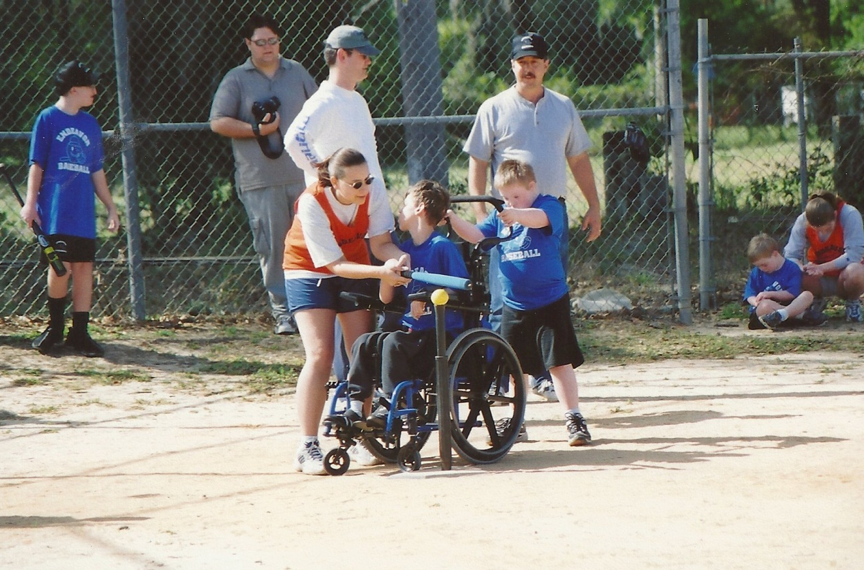
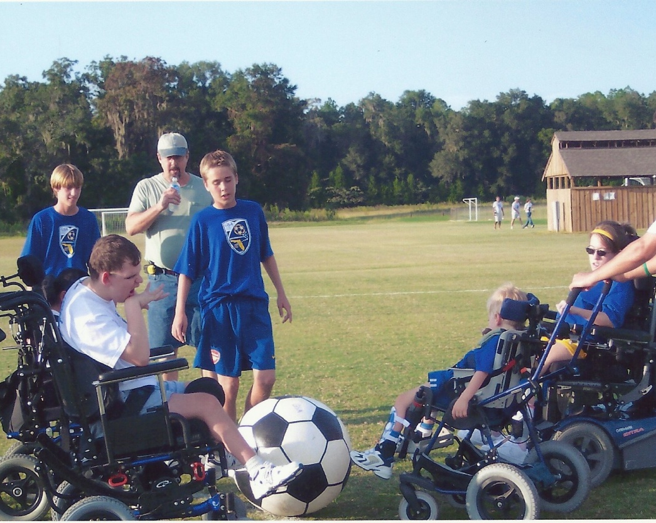

Slide 8
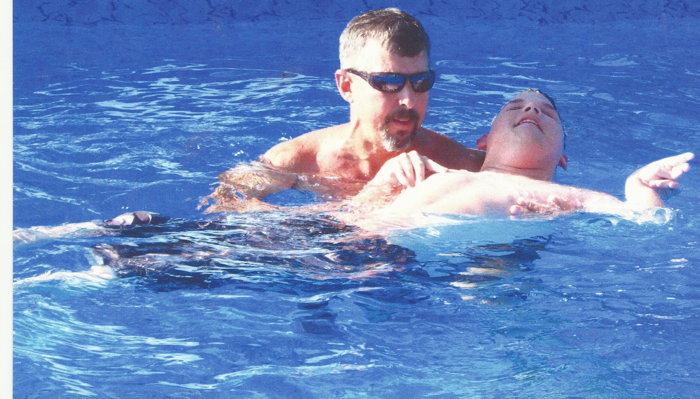

Slide 9
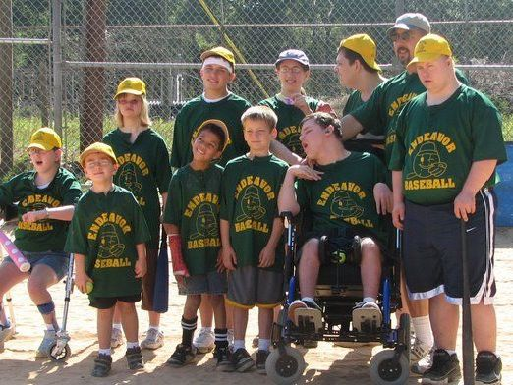

Slide 11
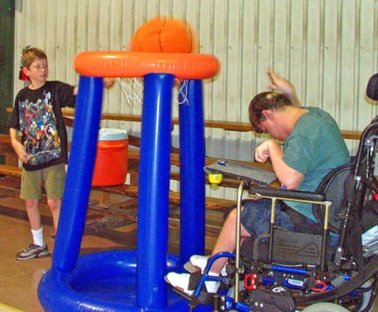

Slide 12
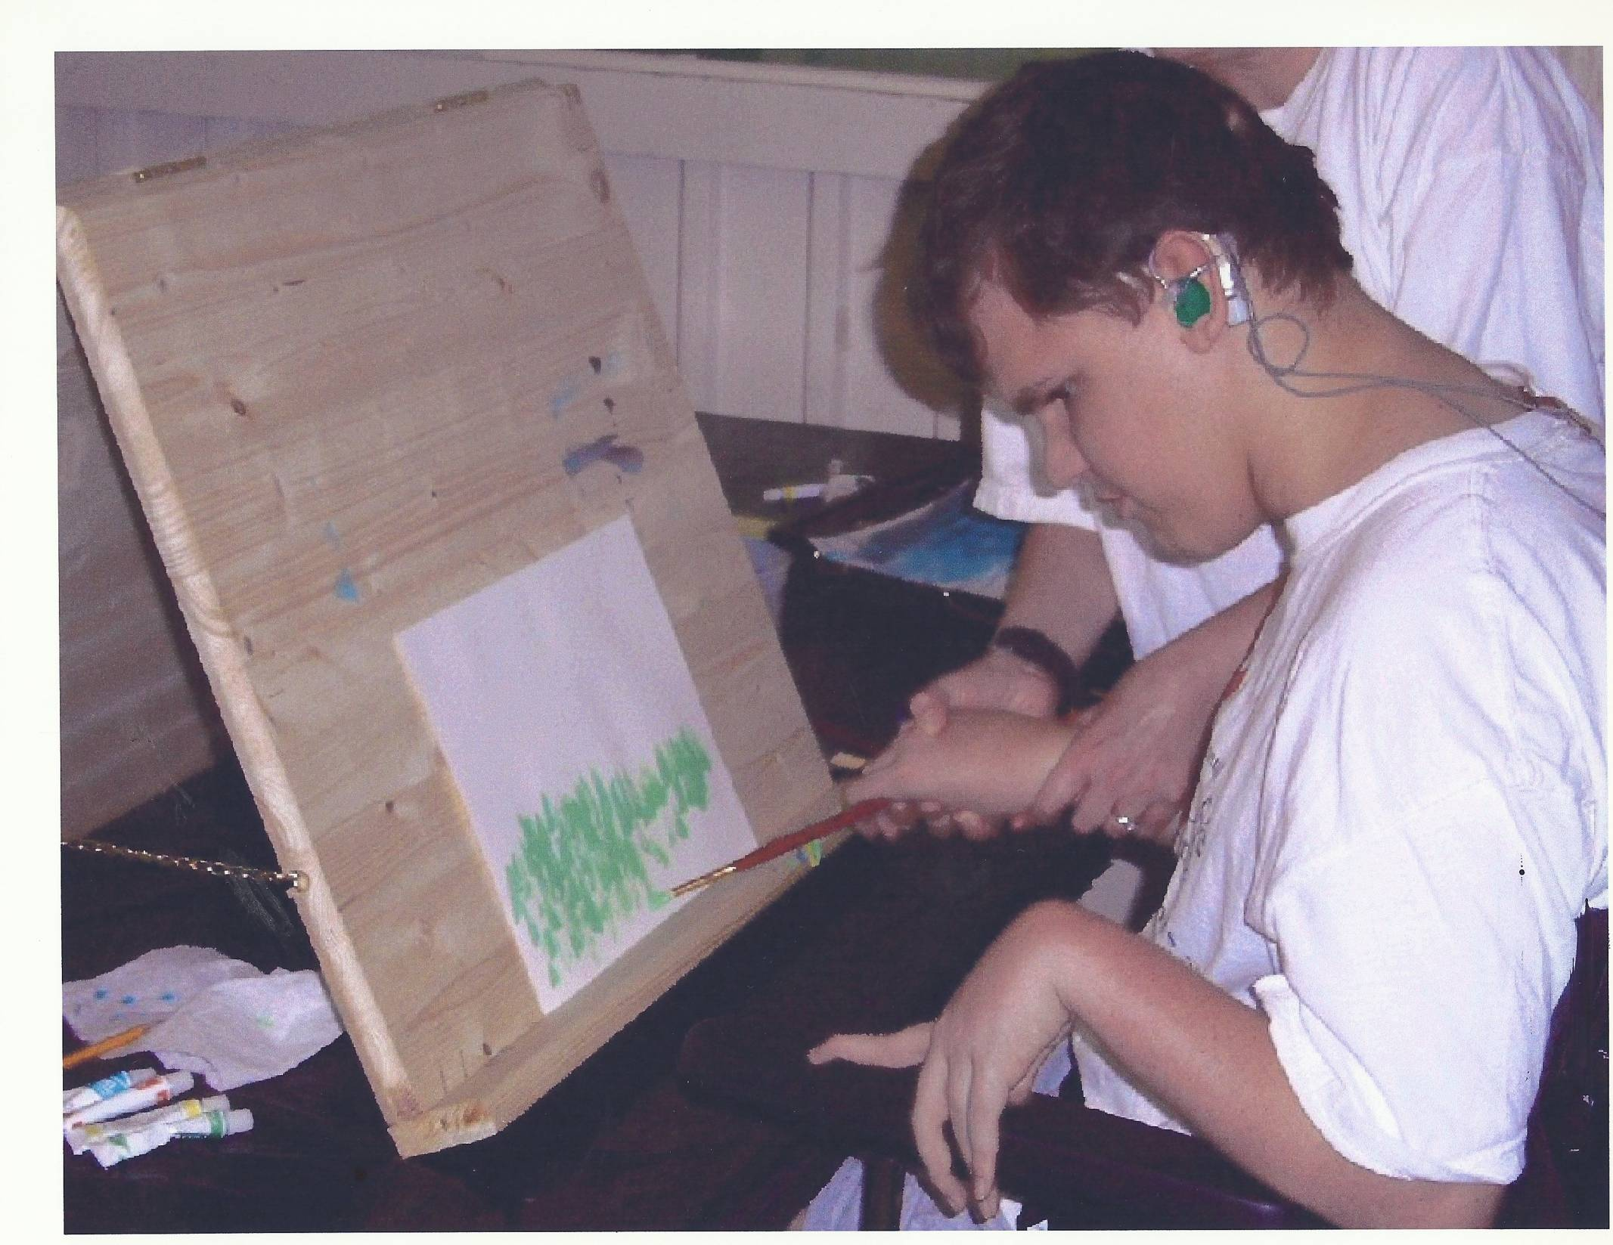

Slide 13
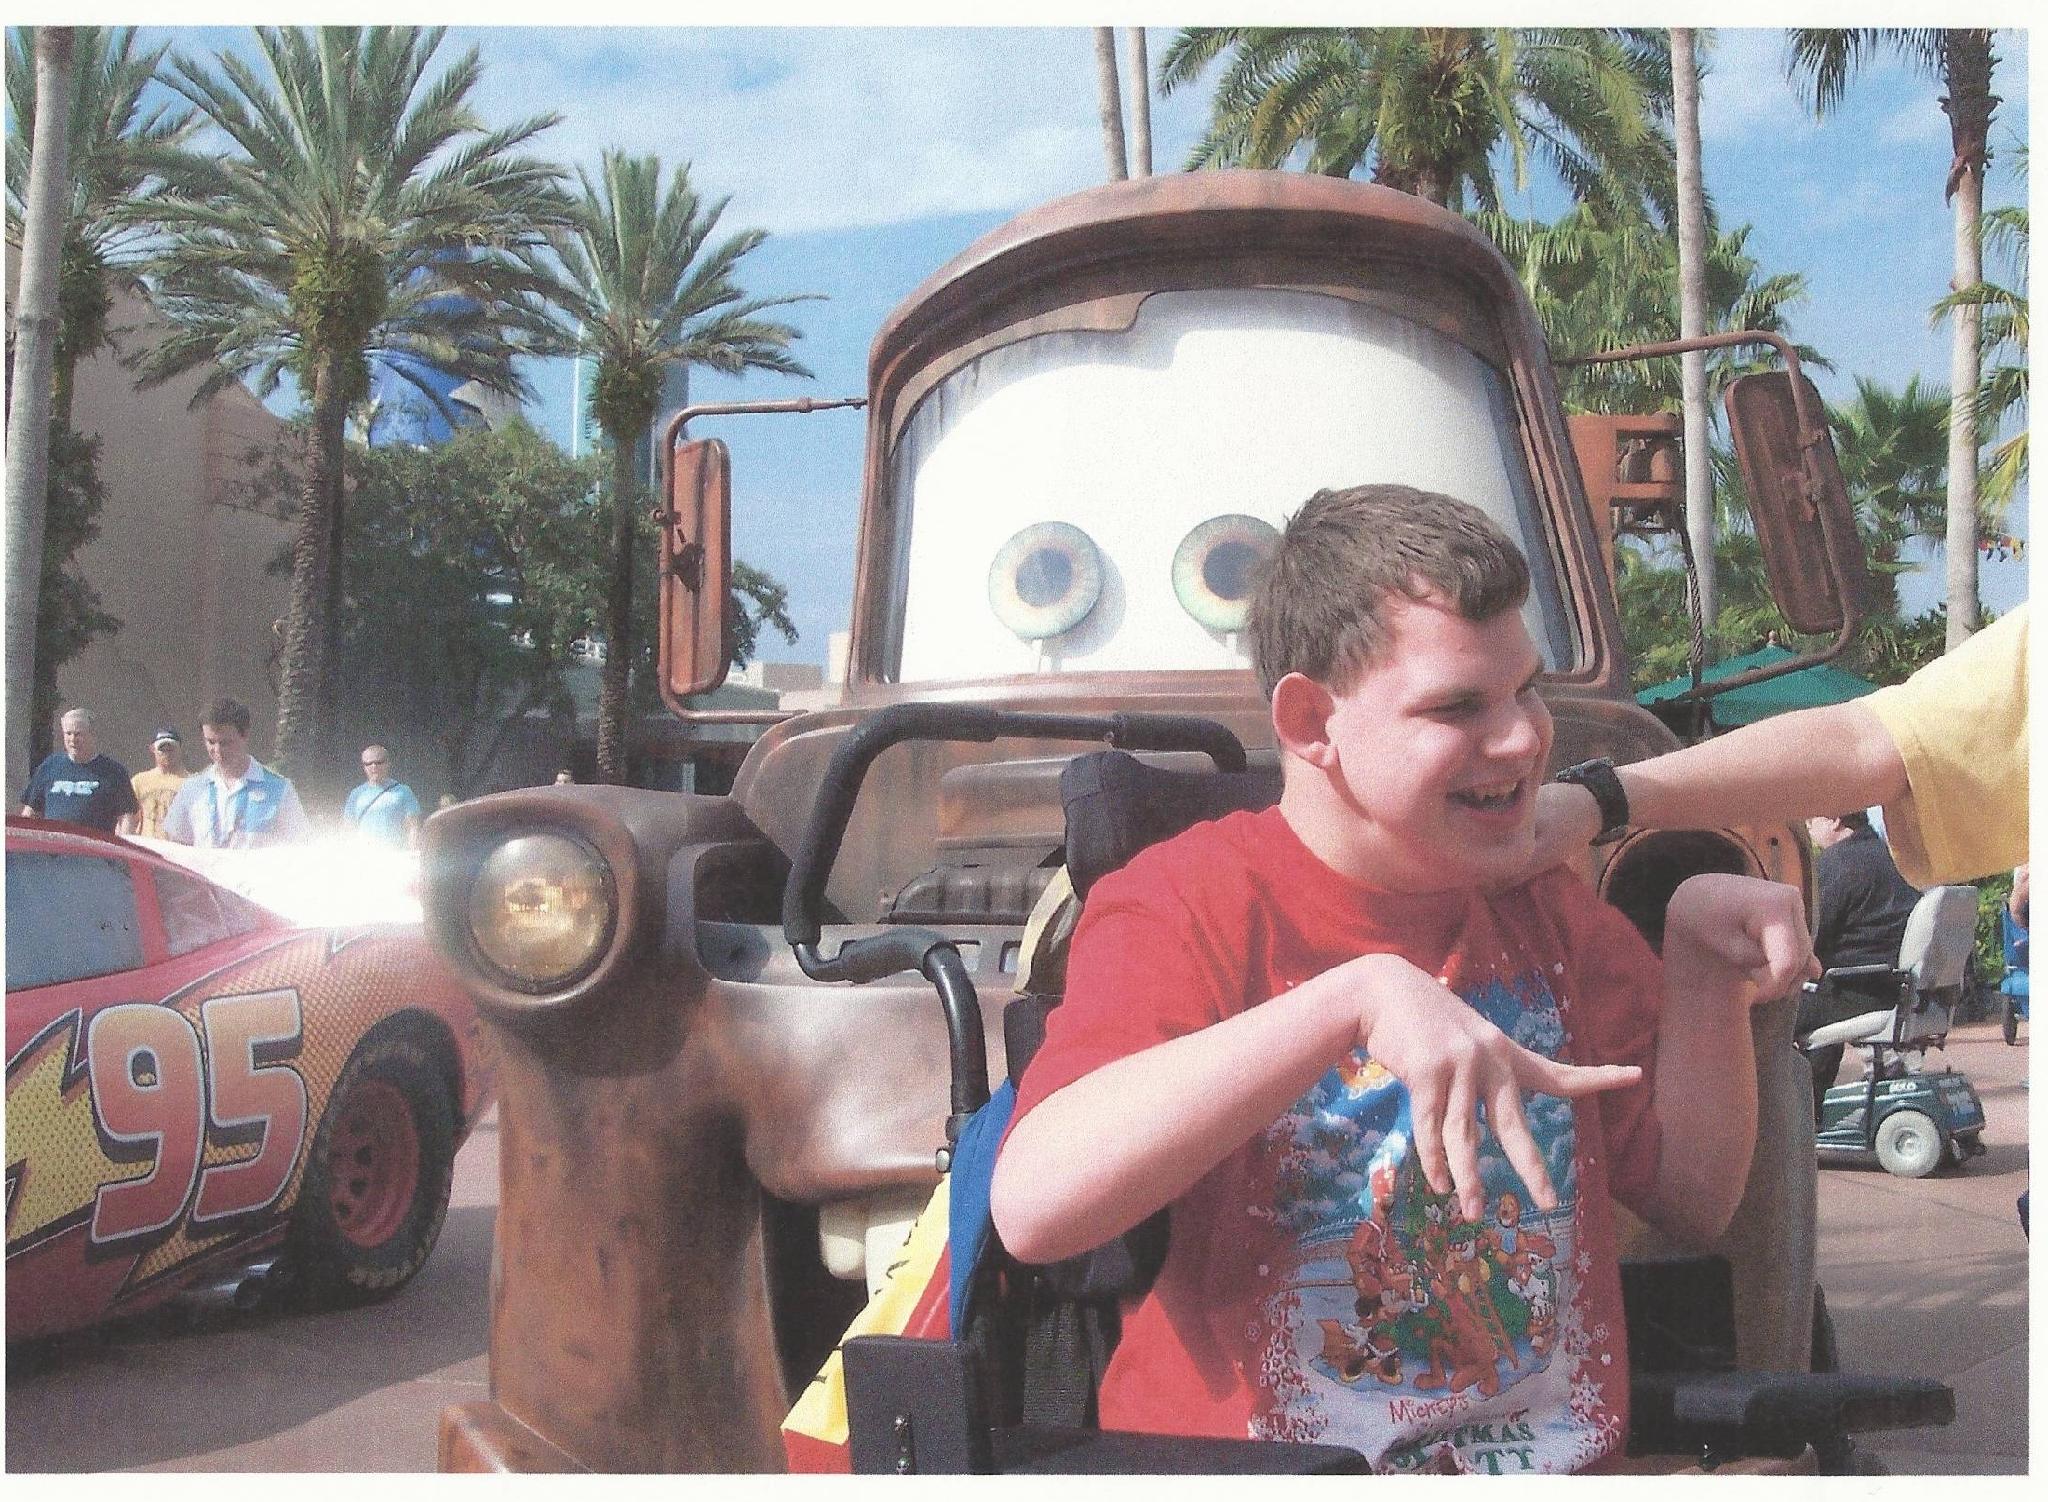

Slide 14
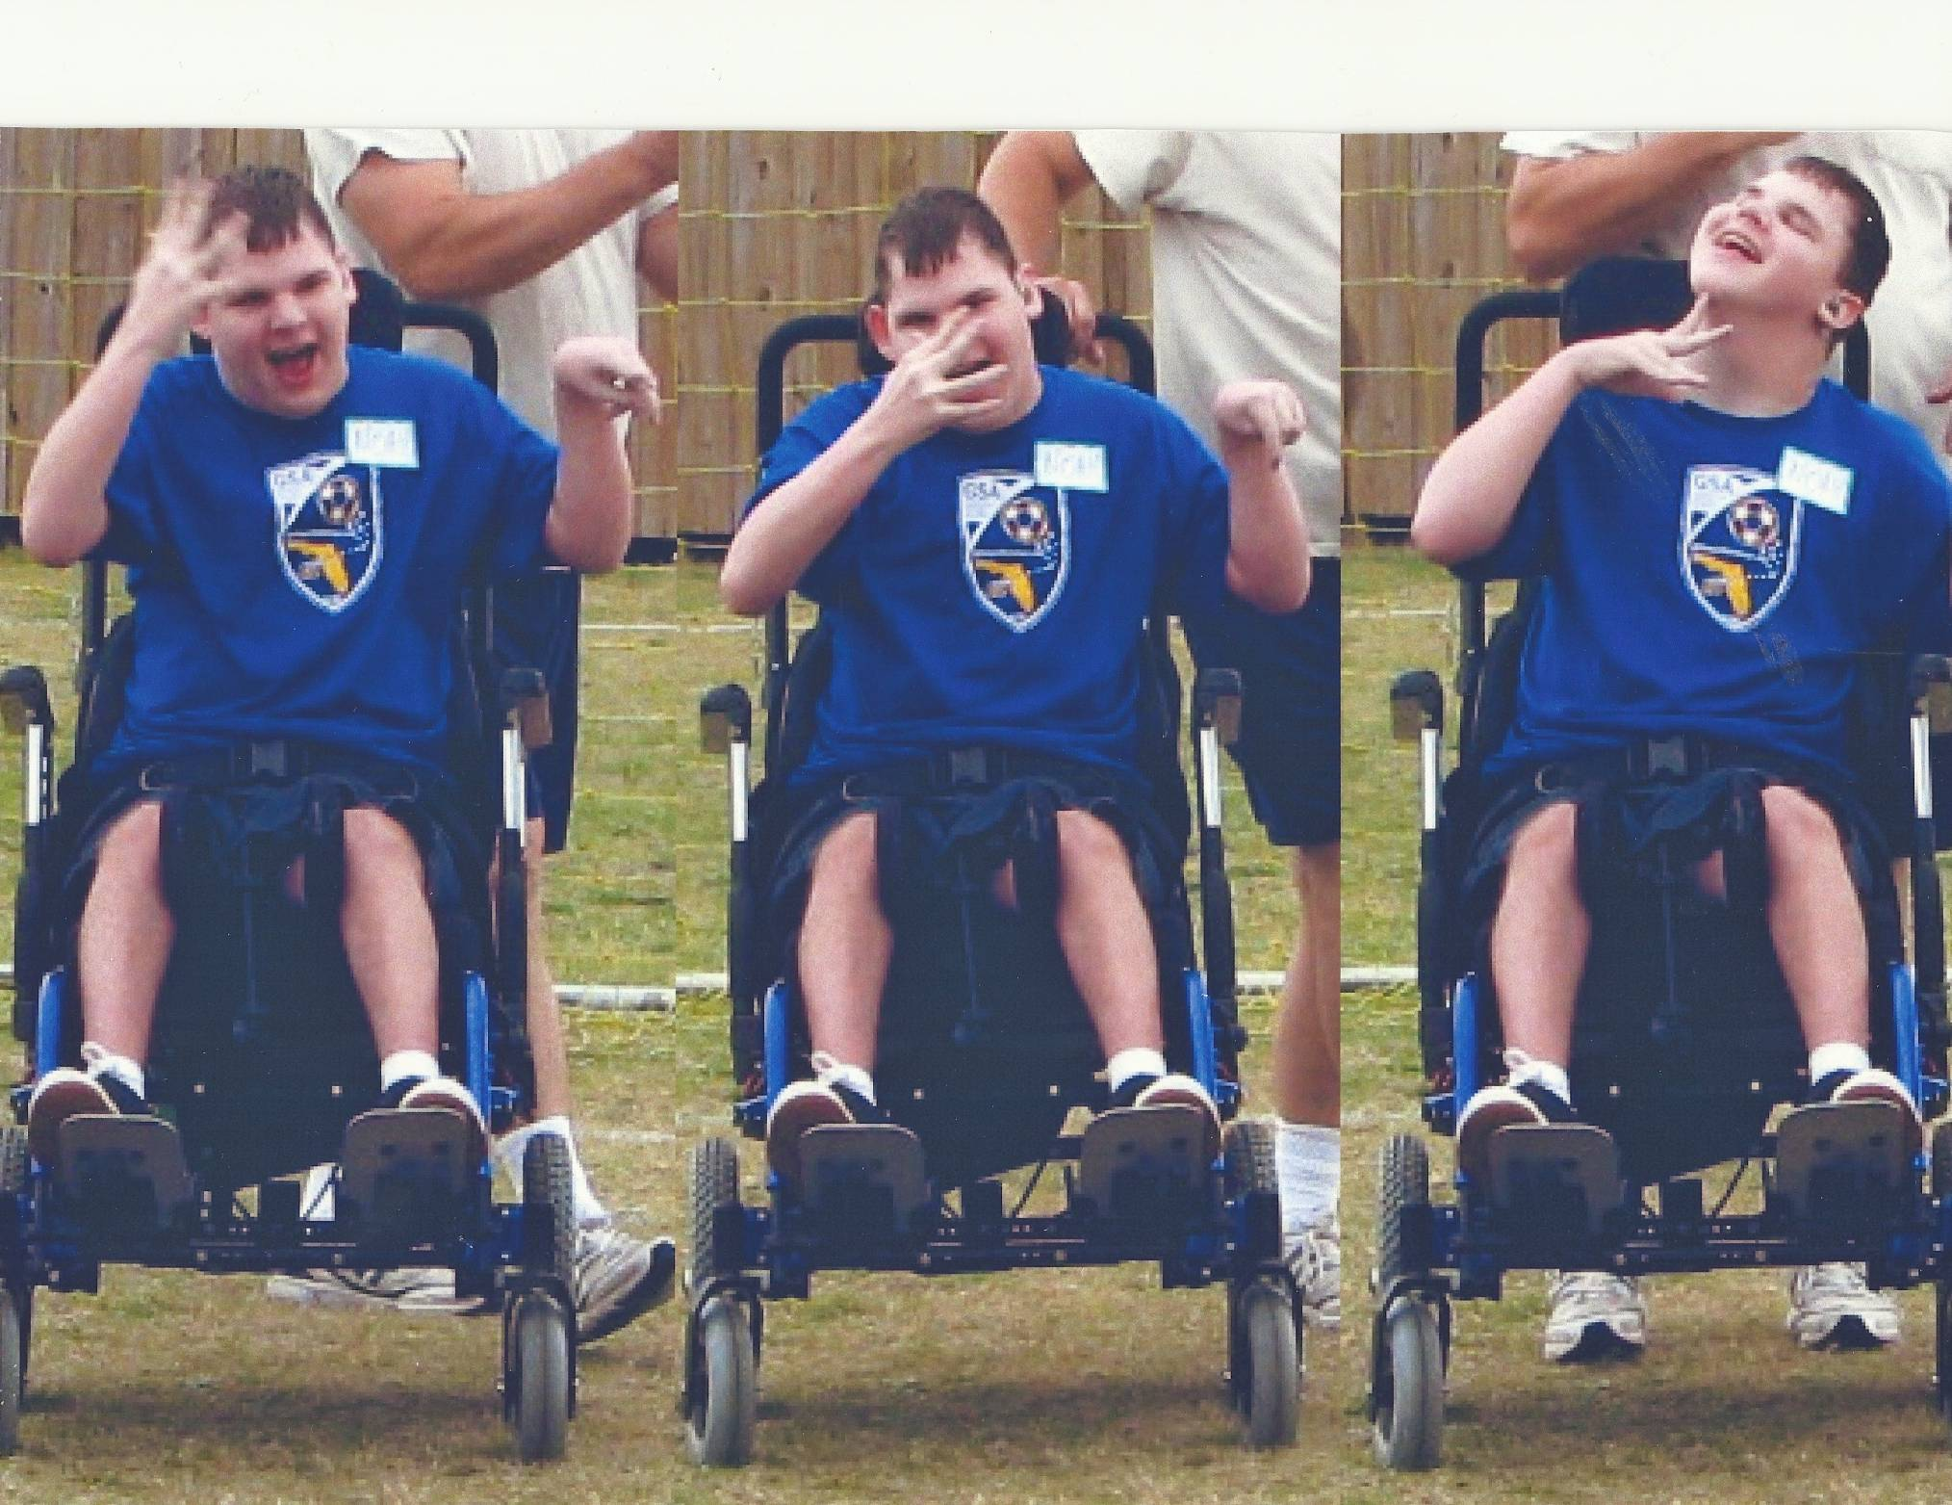

Slide 15
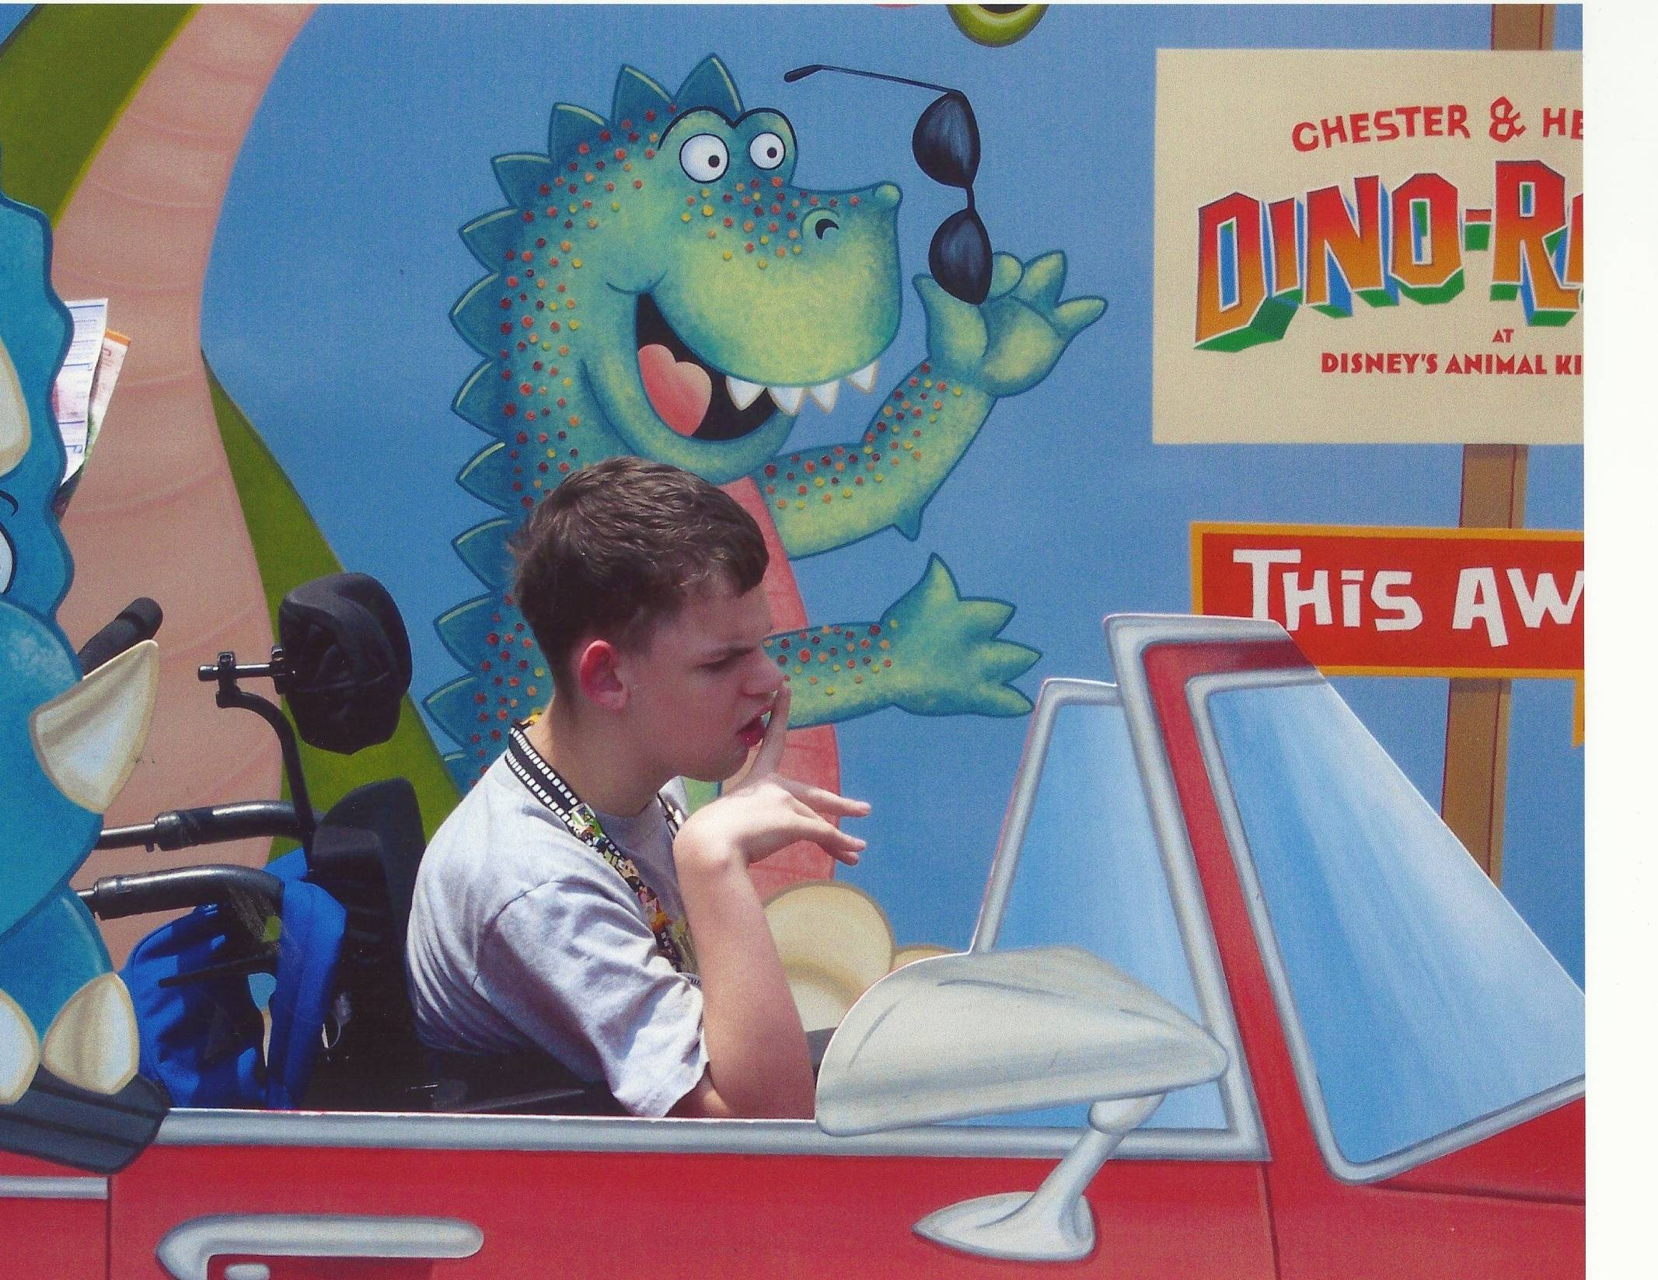

Slide 16
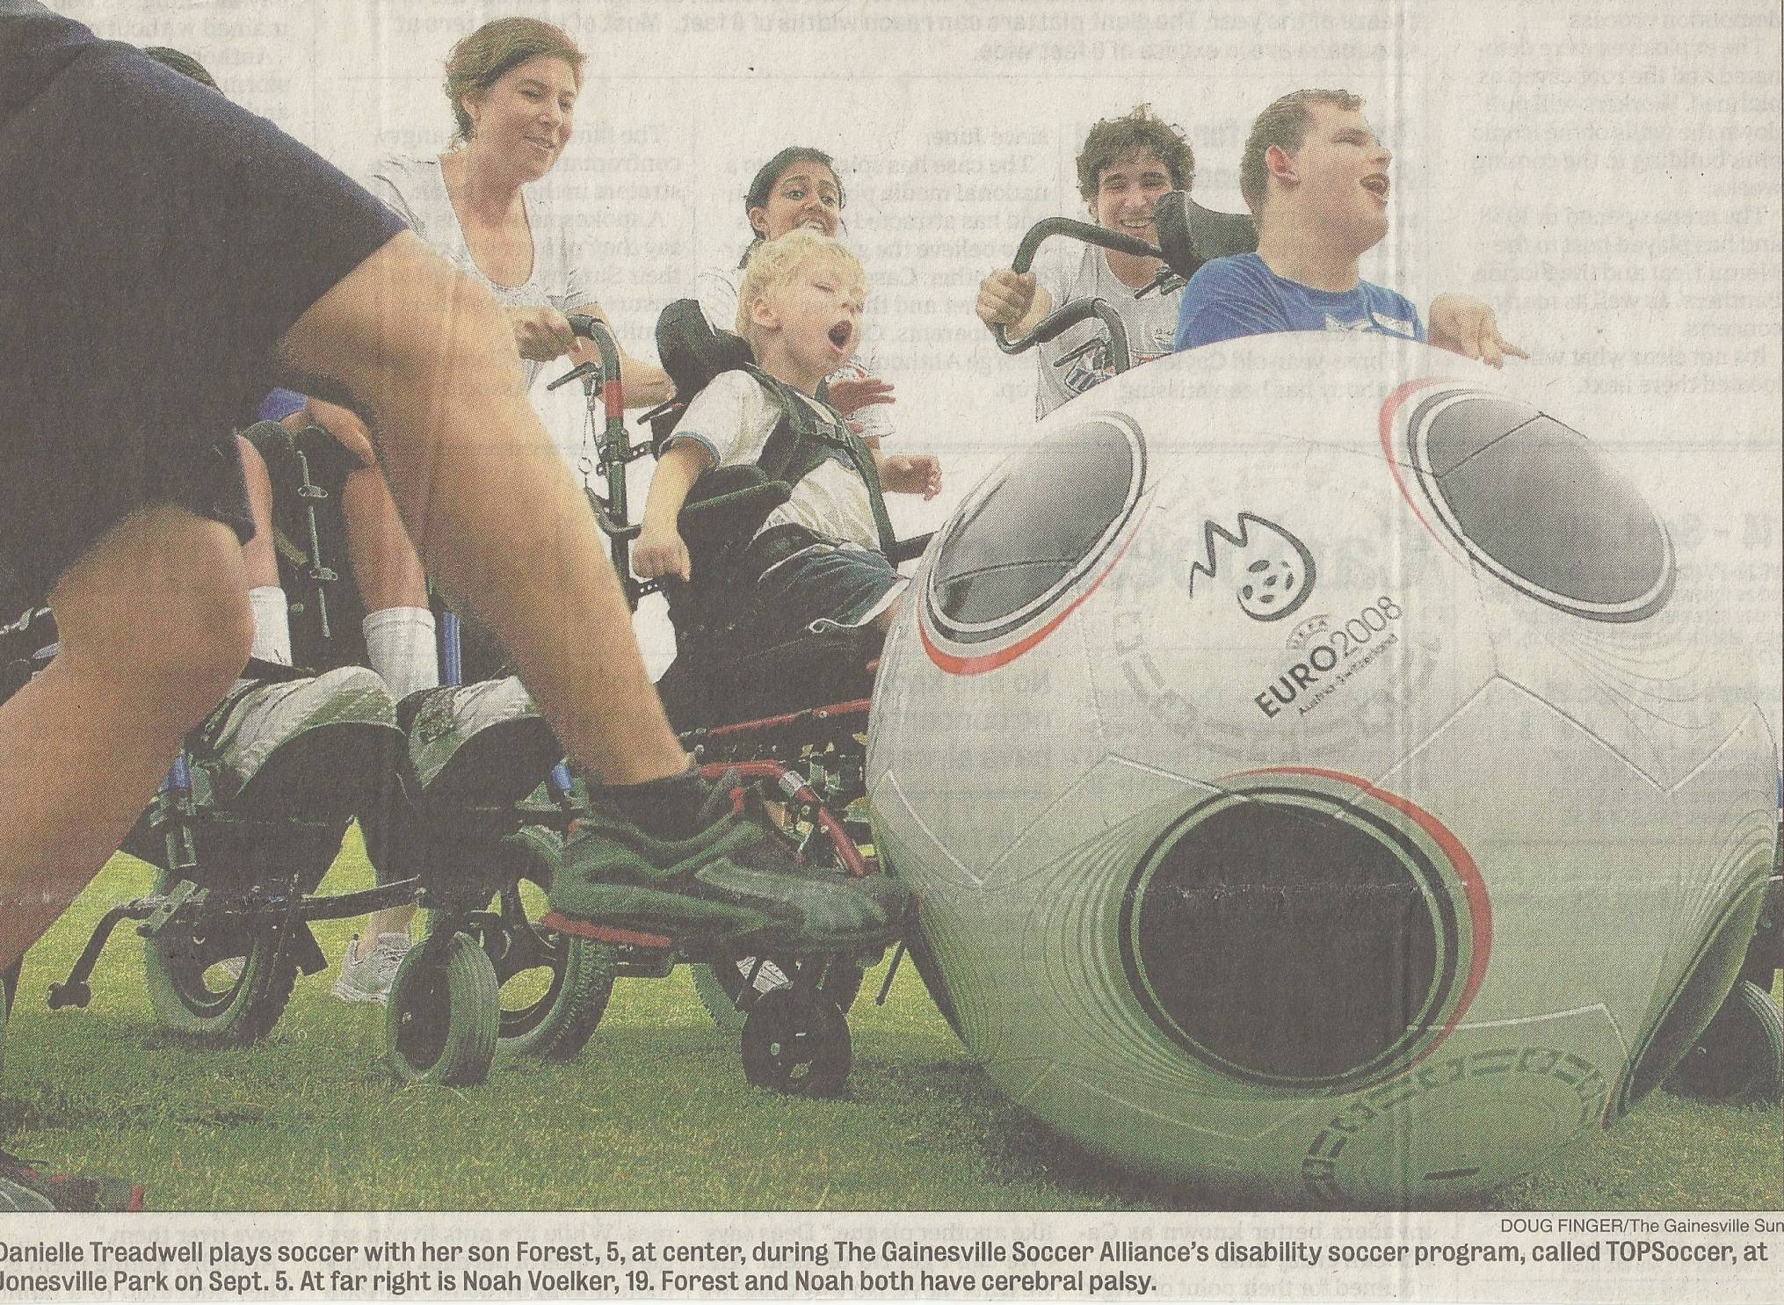

Slide 17
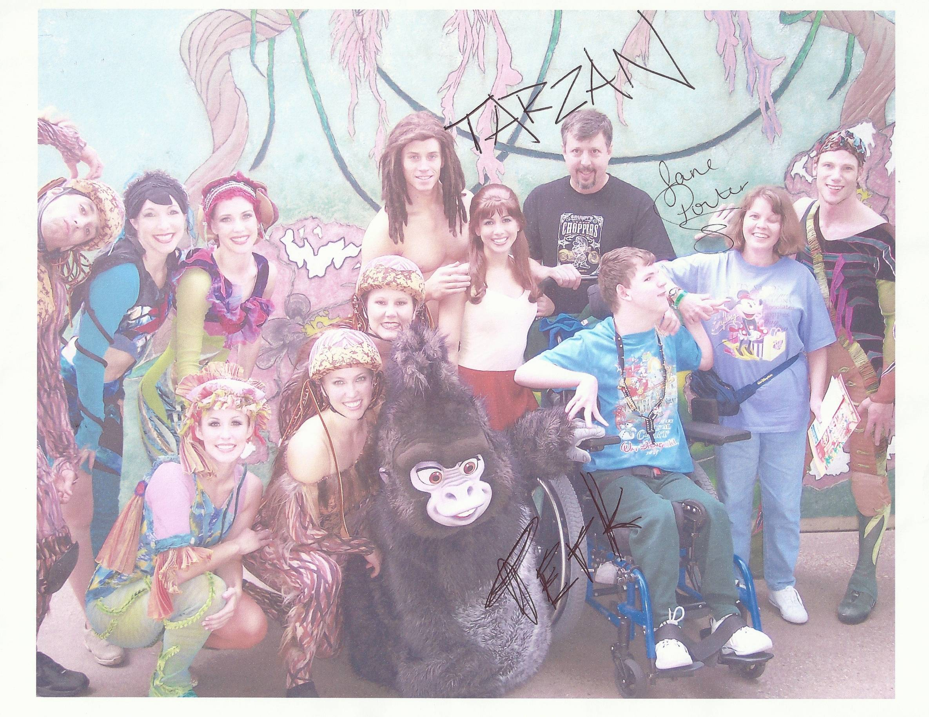

Slide 18
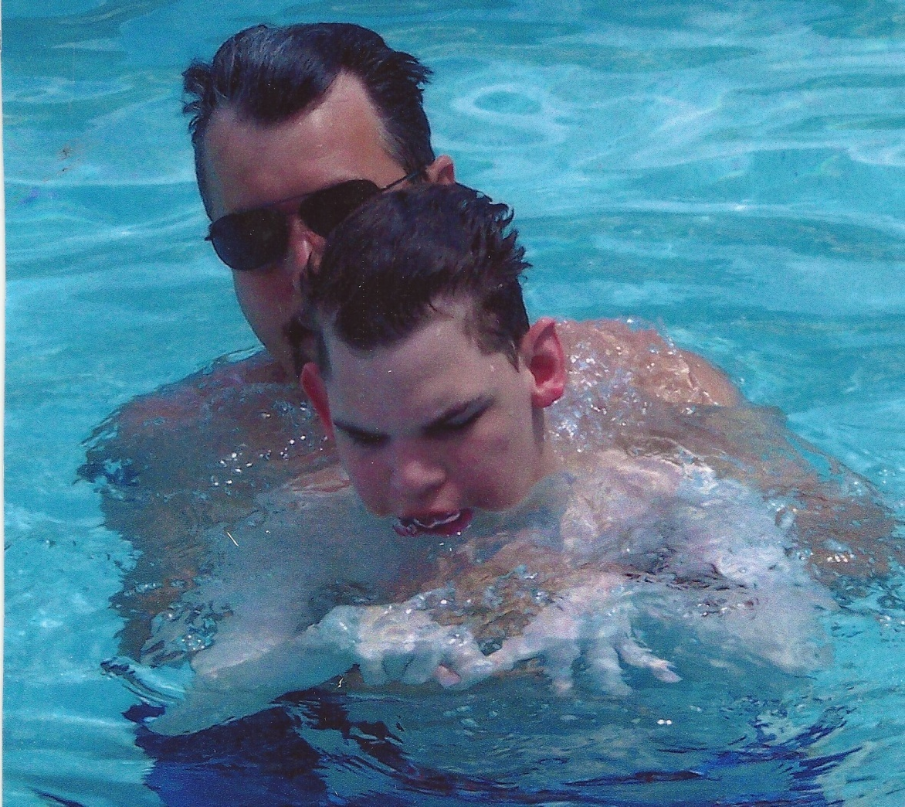
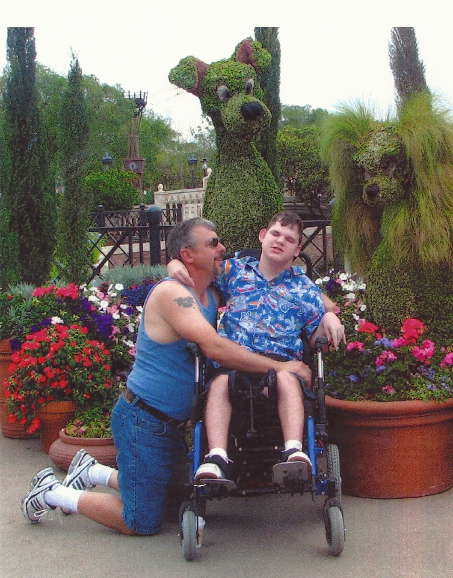

Slide 19
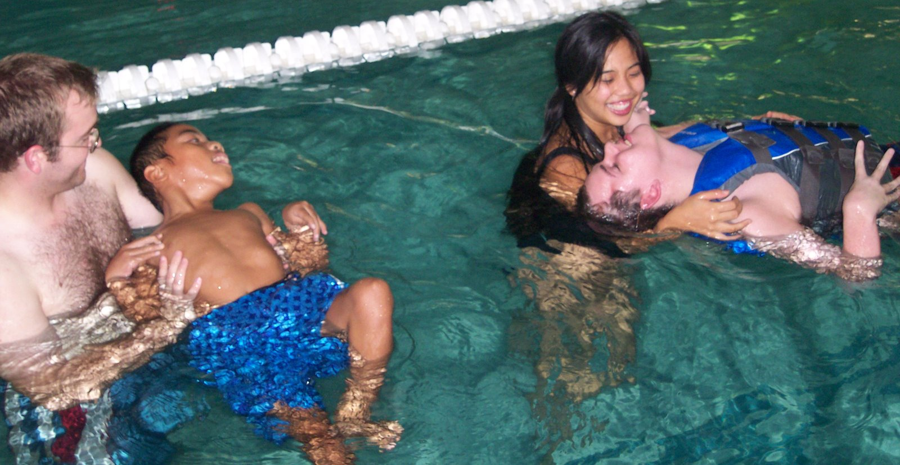
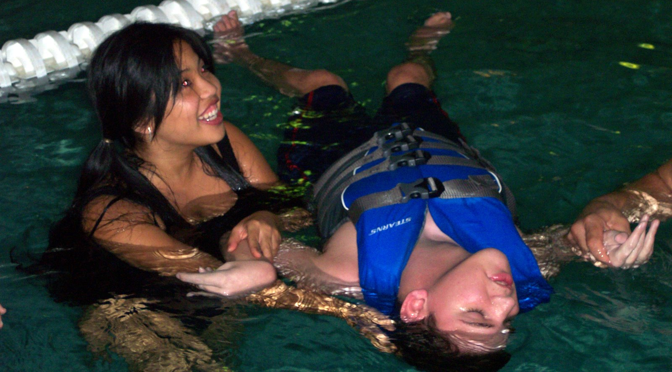
www.noahsendeavor.org

Slide 20
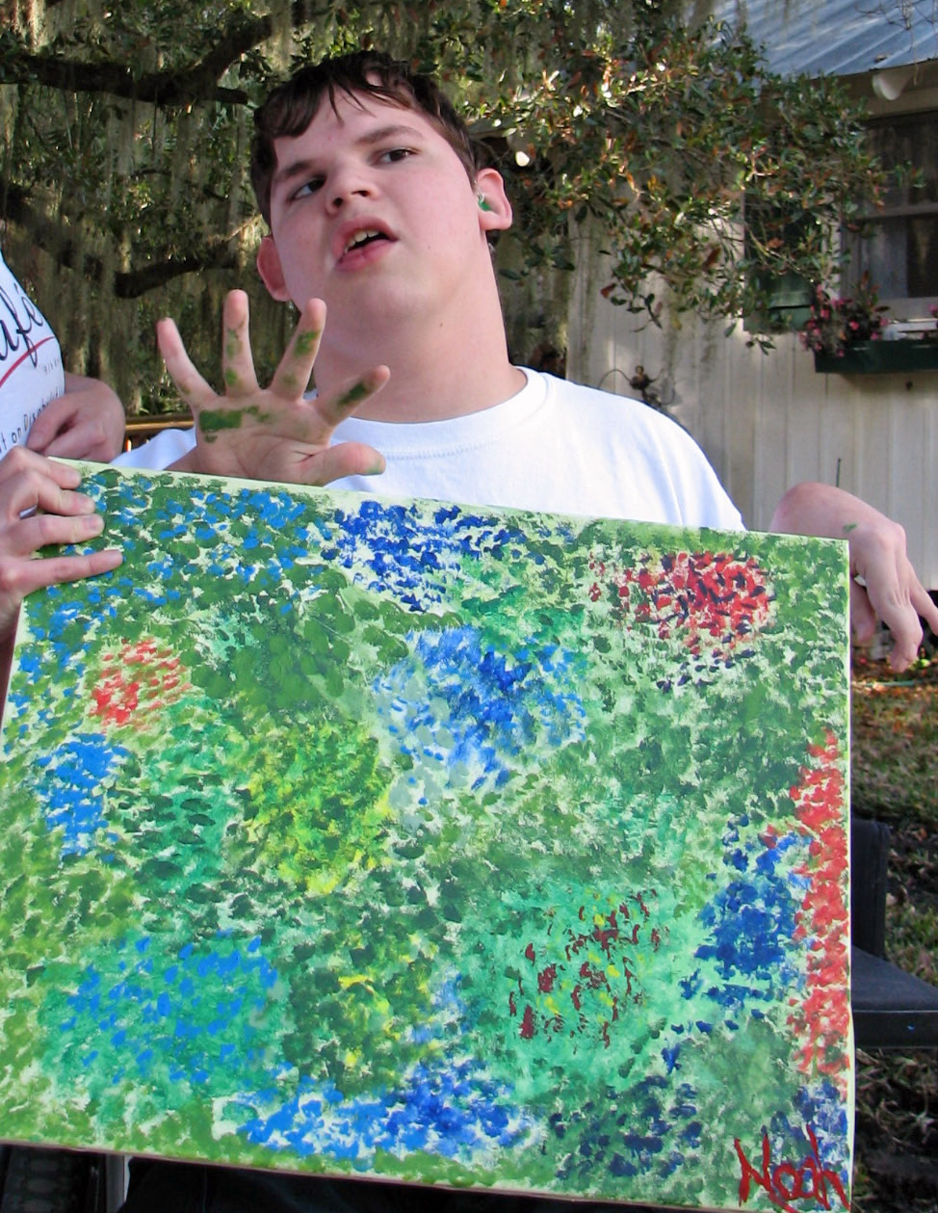

Slide 21
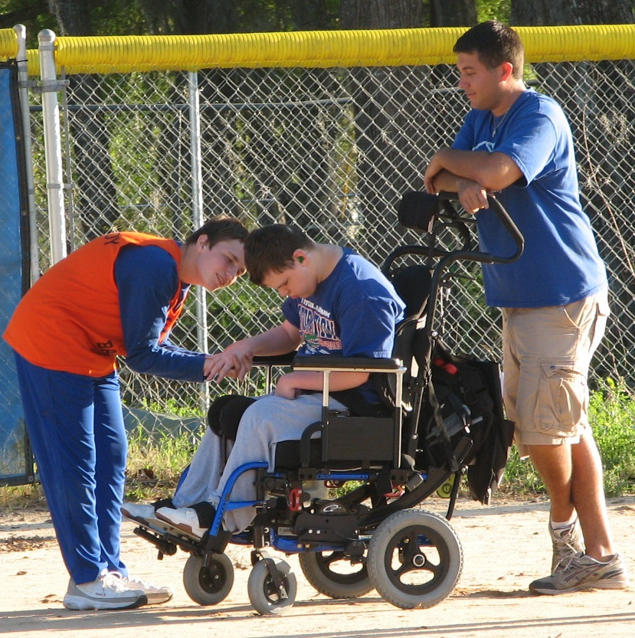
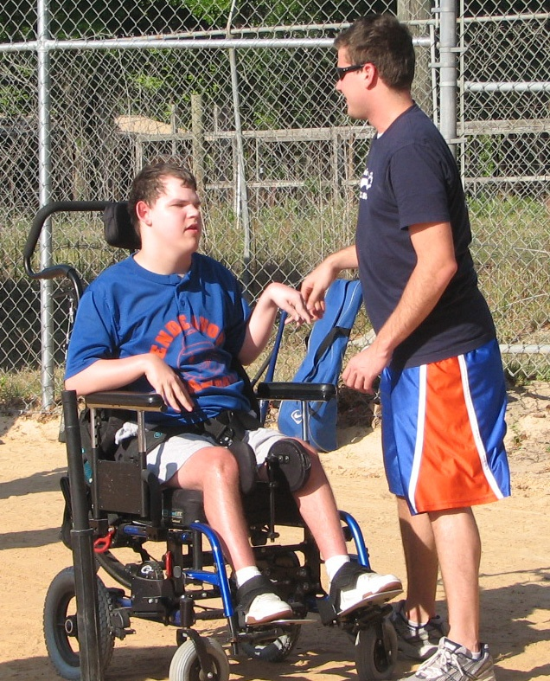

Slide 22
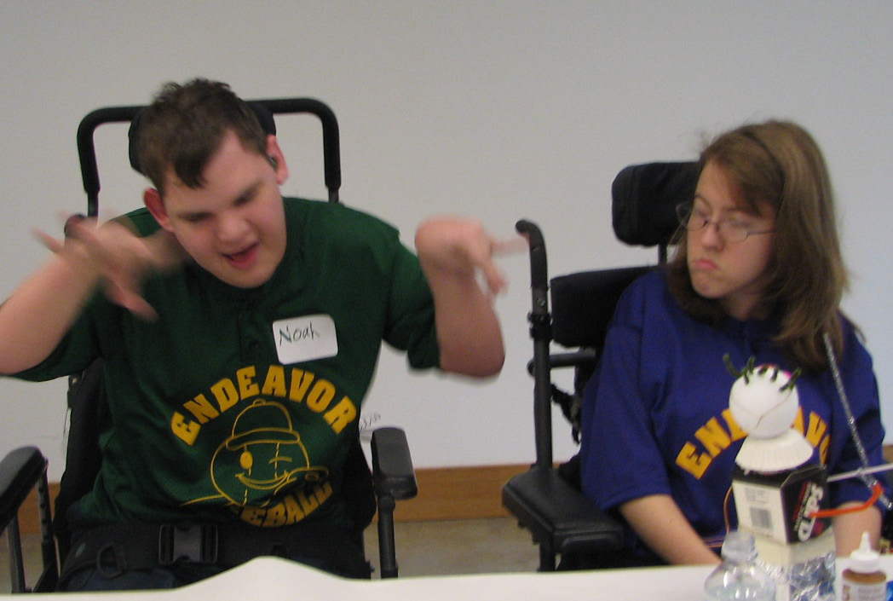
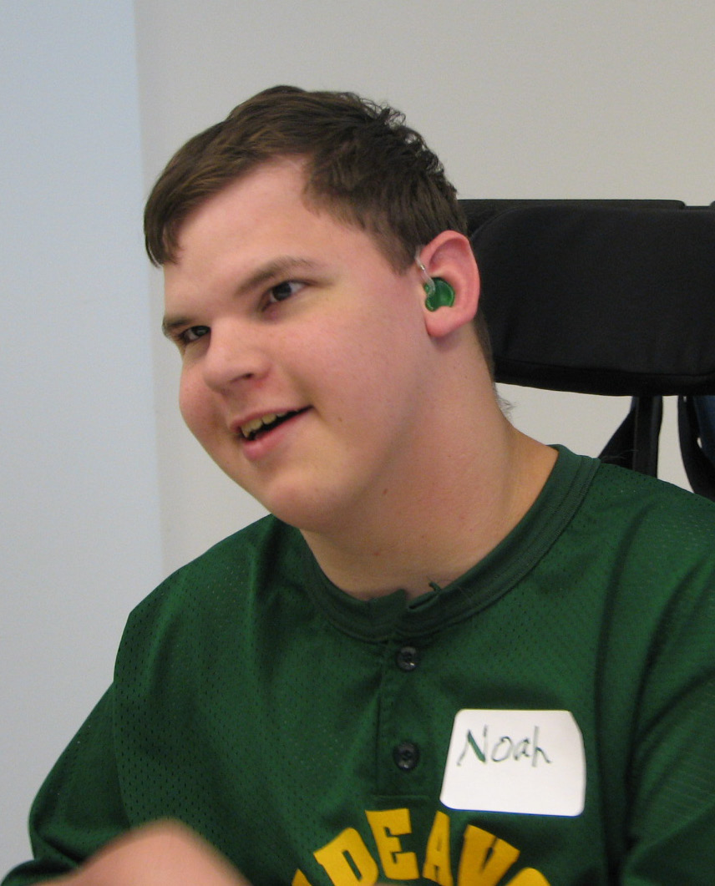

Slide 23
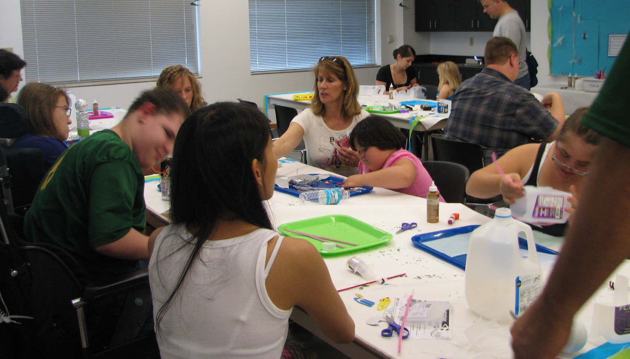

Slide 24
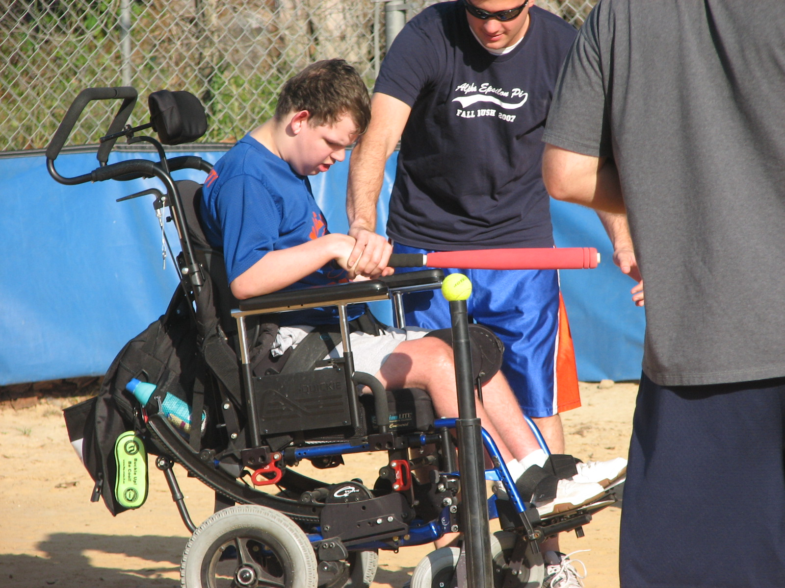

Slide 25
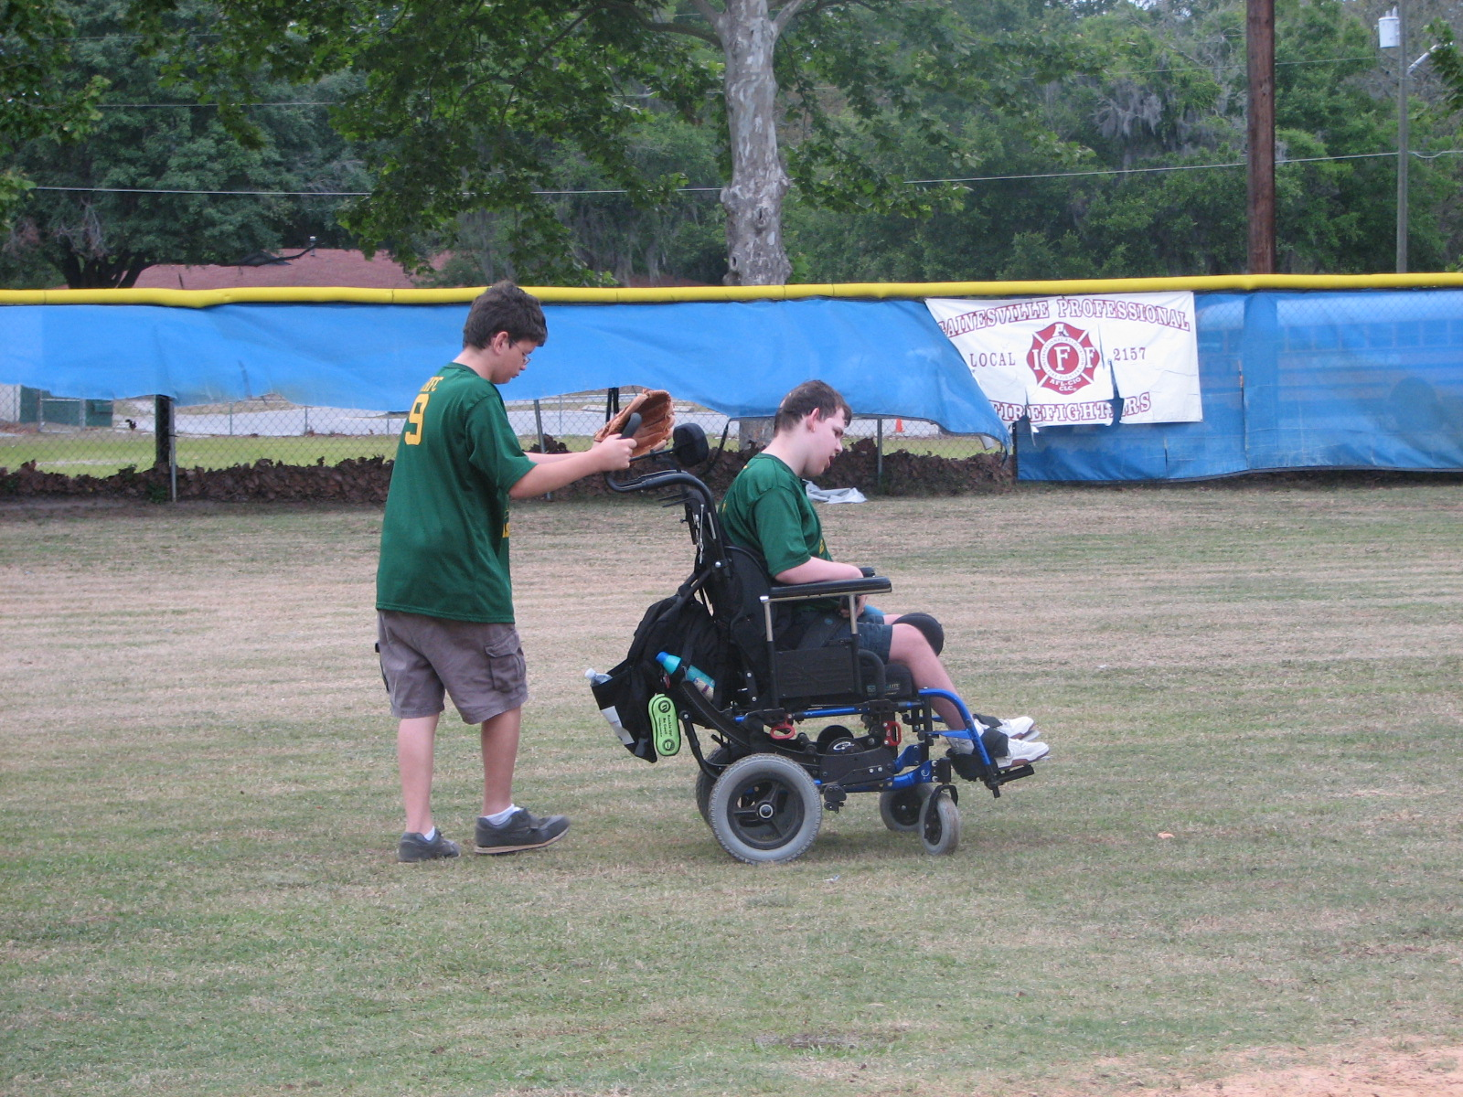

Slide 26
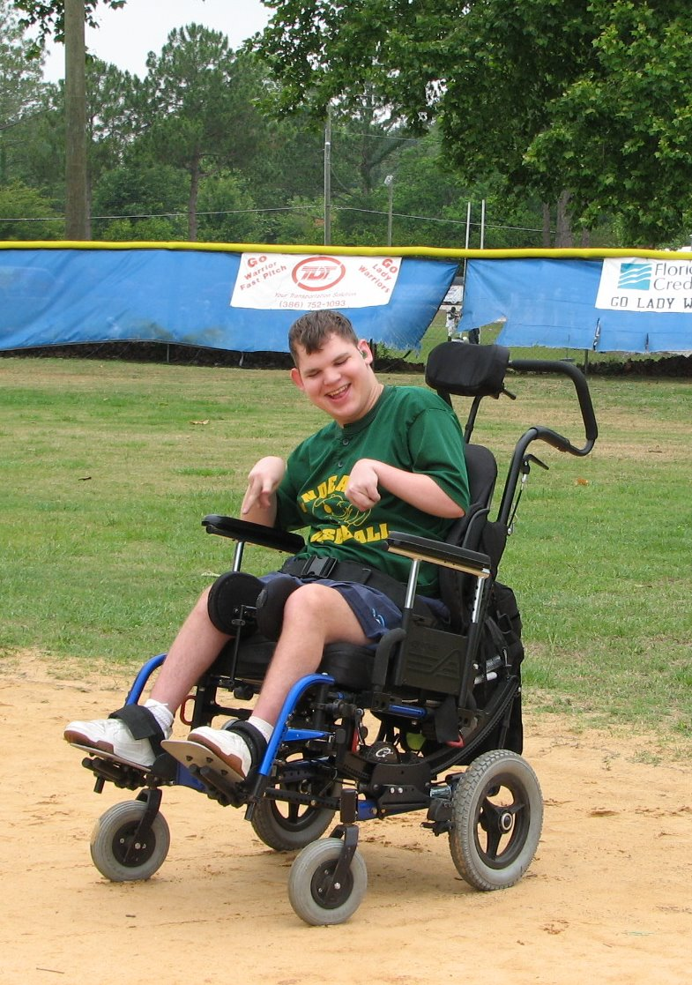

Slide 27
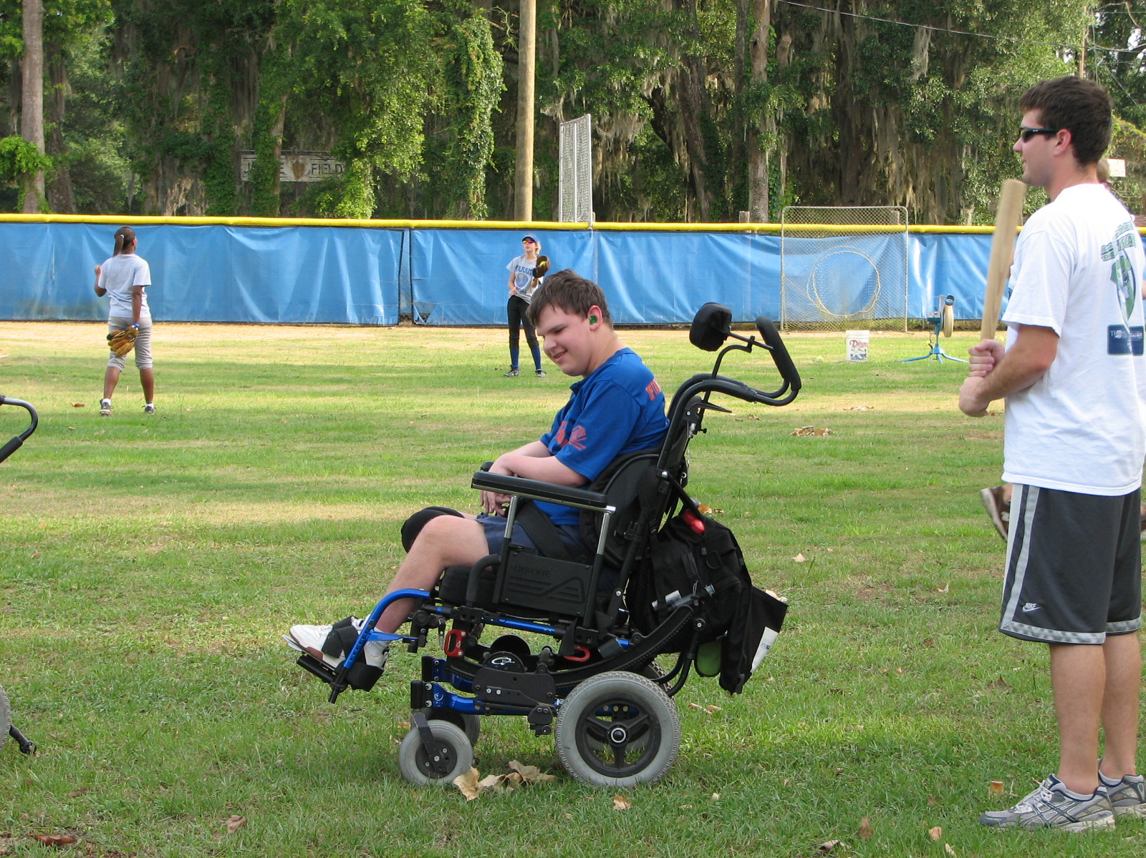

Slide 28
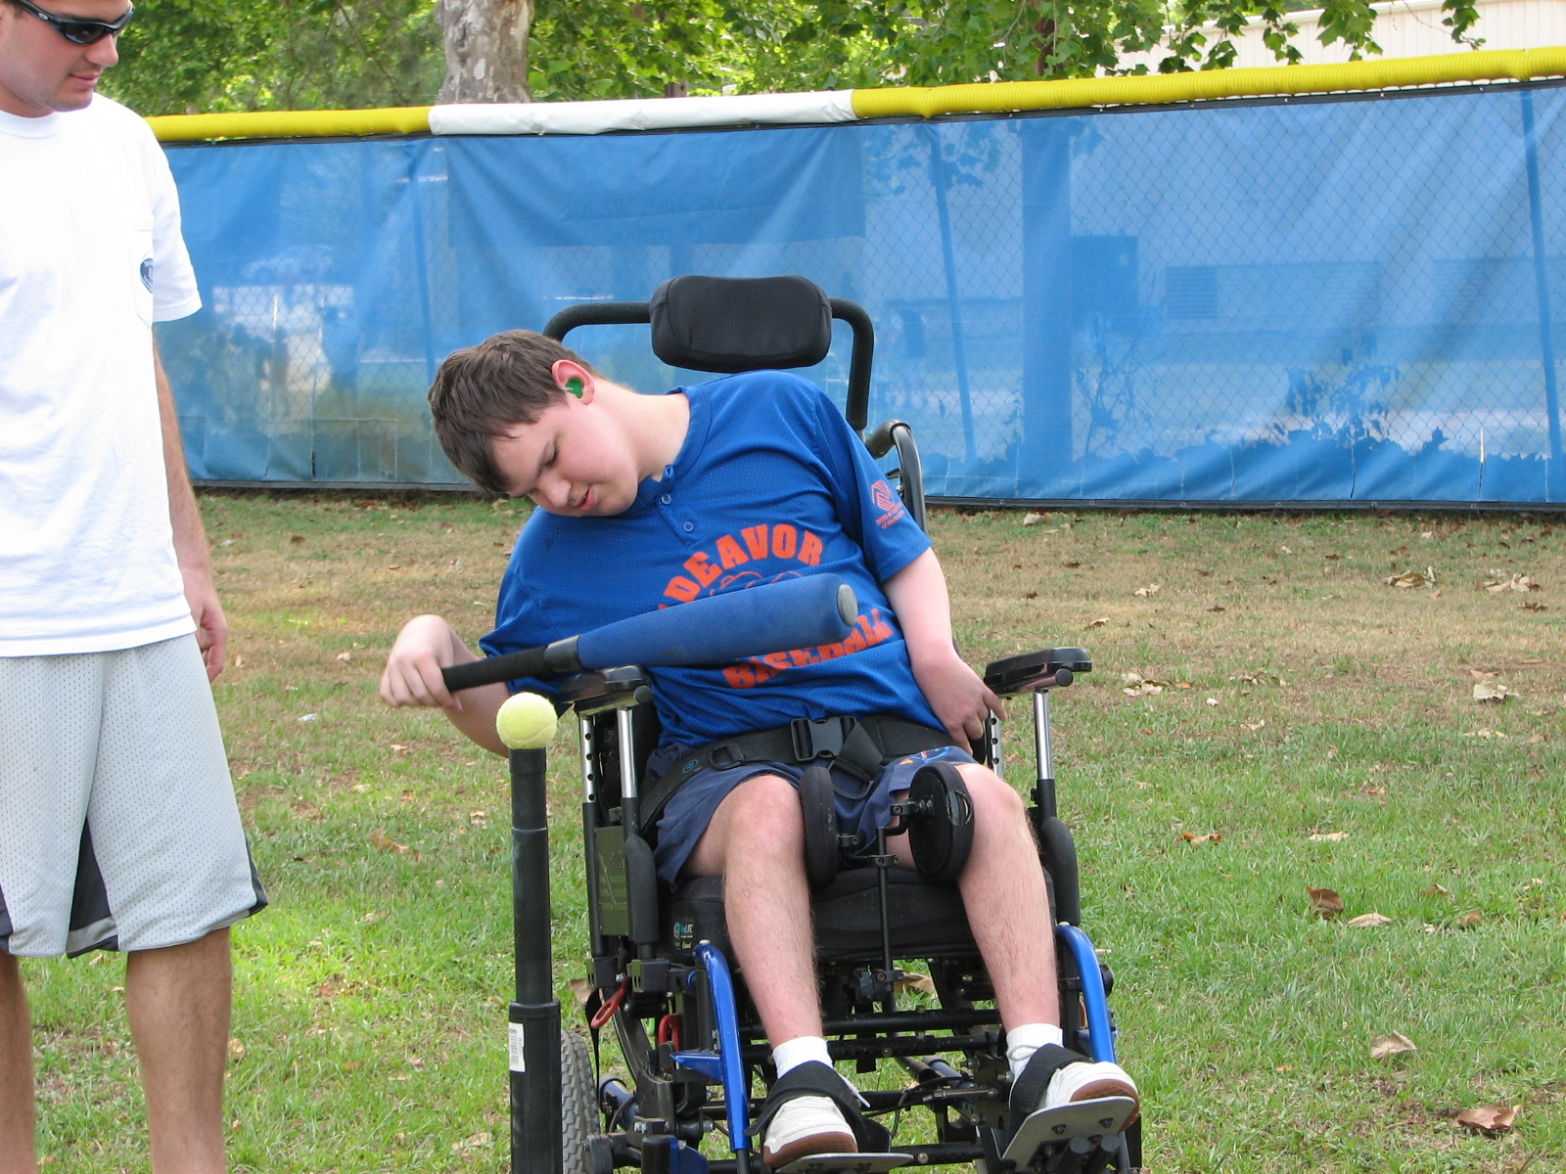
www.noahsendeavor.org

Slide 29
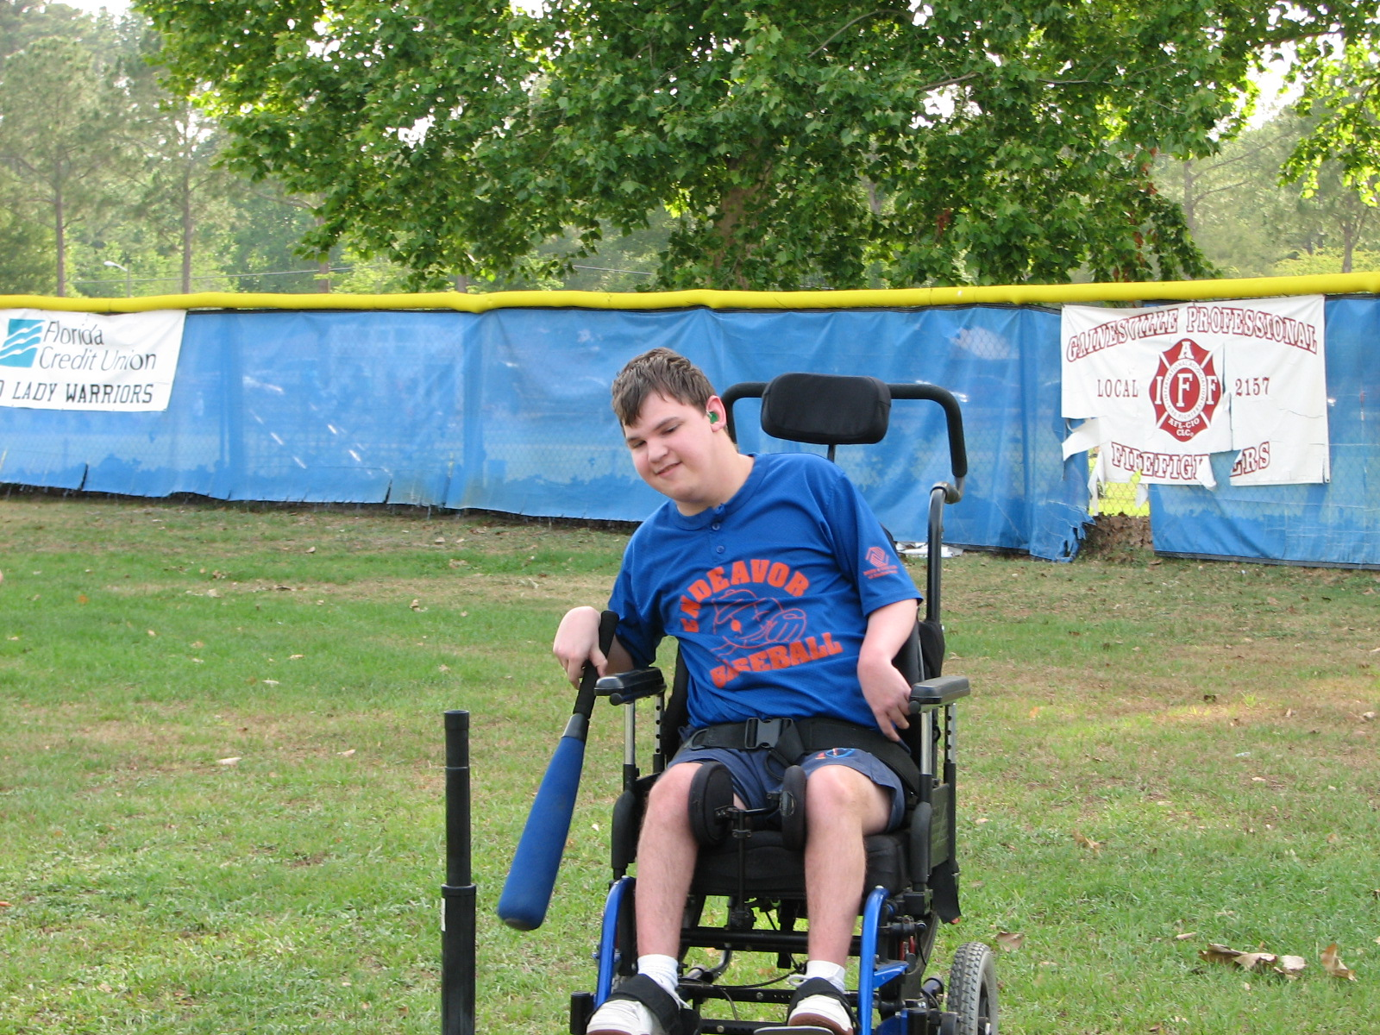
www.noahsendeavor.org

Slide 30
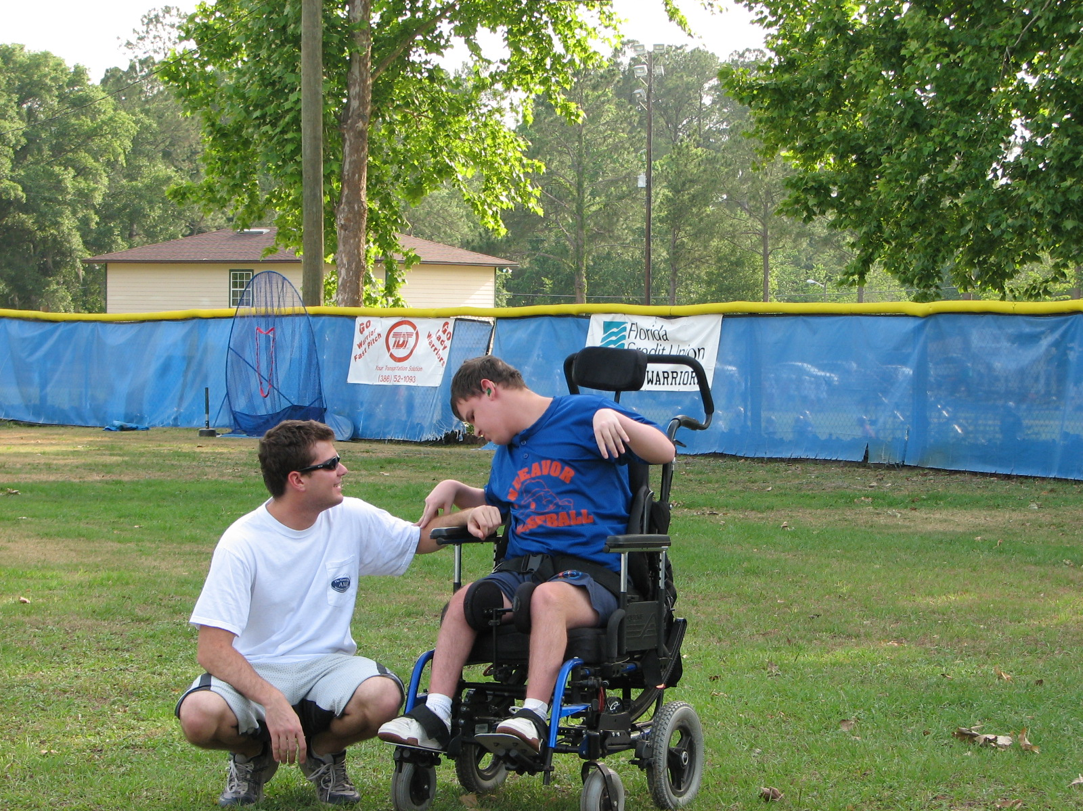
www.noahsendeavor.org

Slide 31
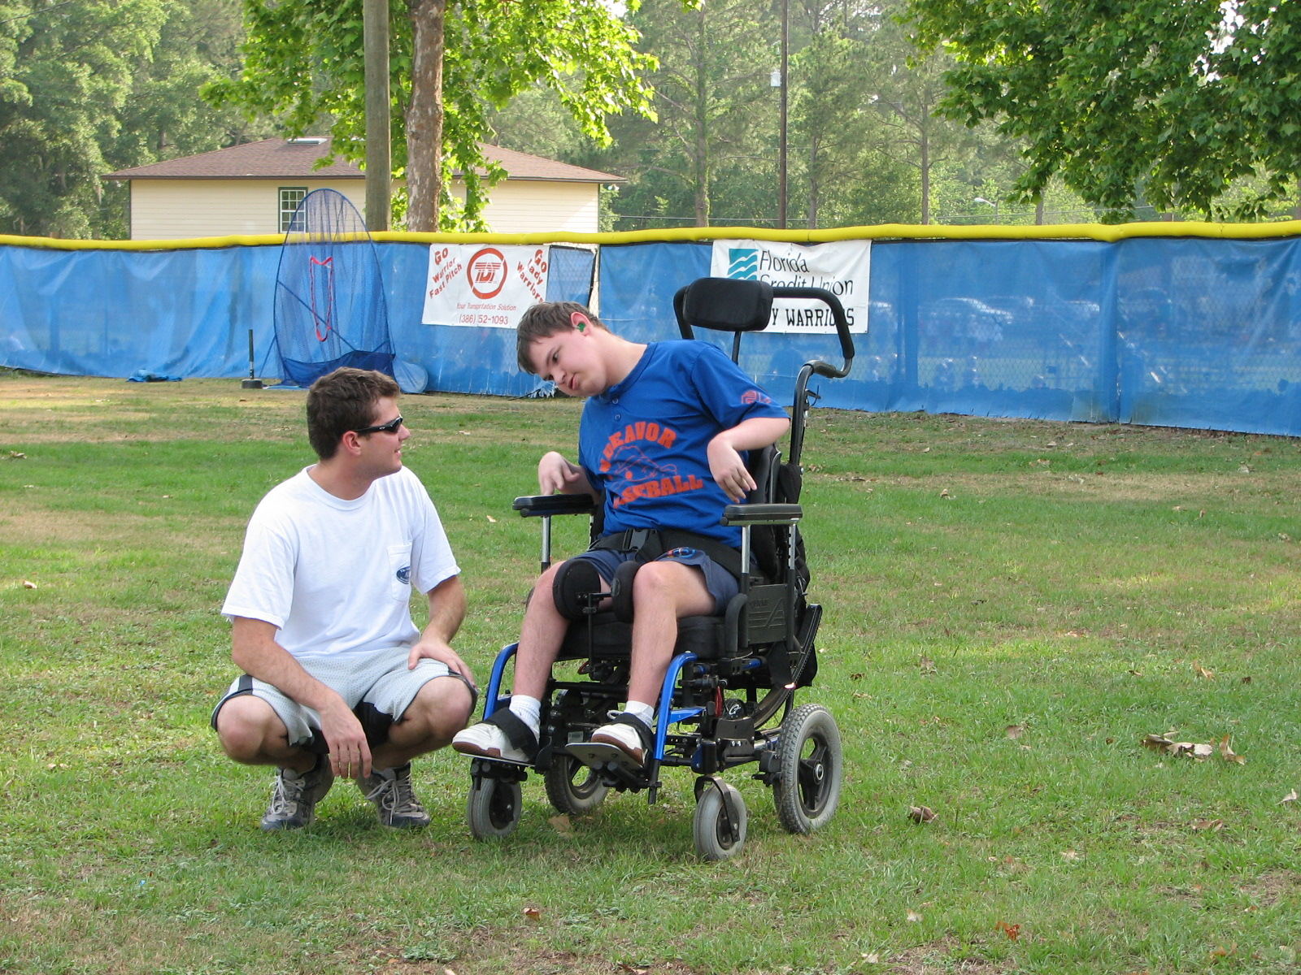

Slide 32
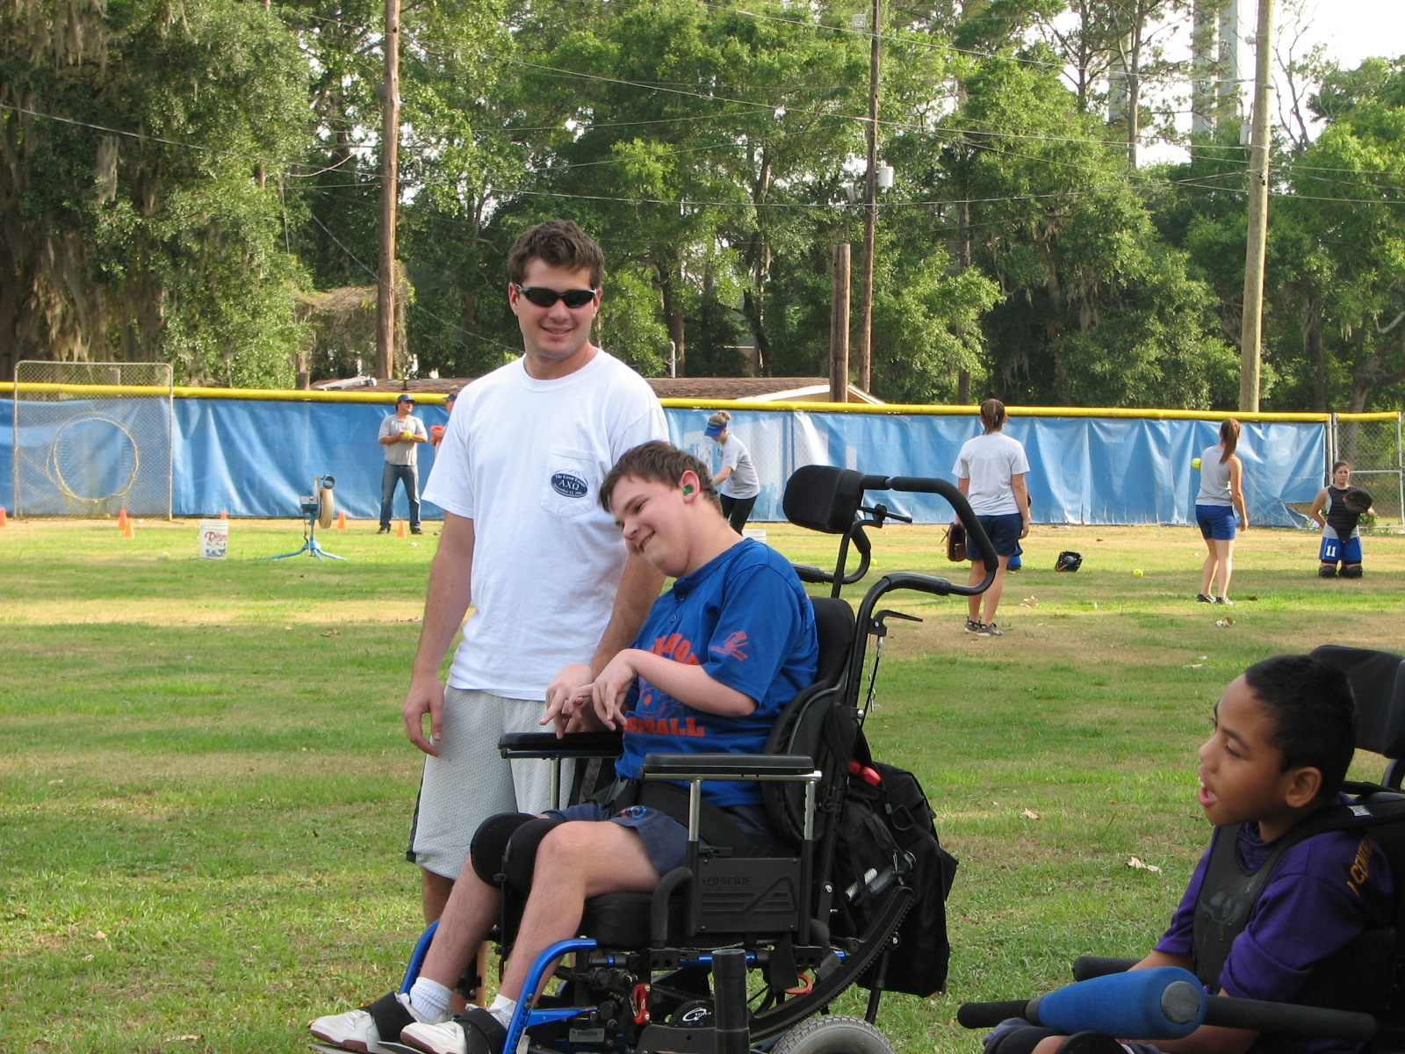
www.noahsendeavor.org

Slide 33
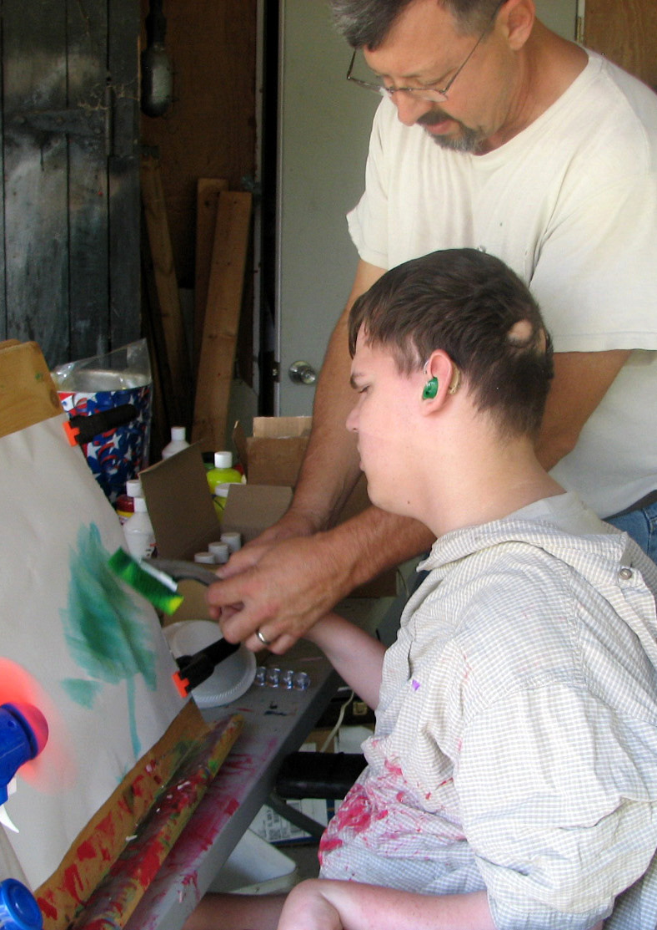

Slide 34
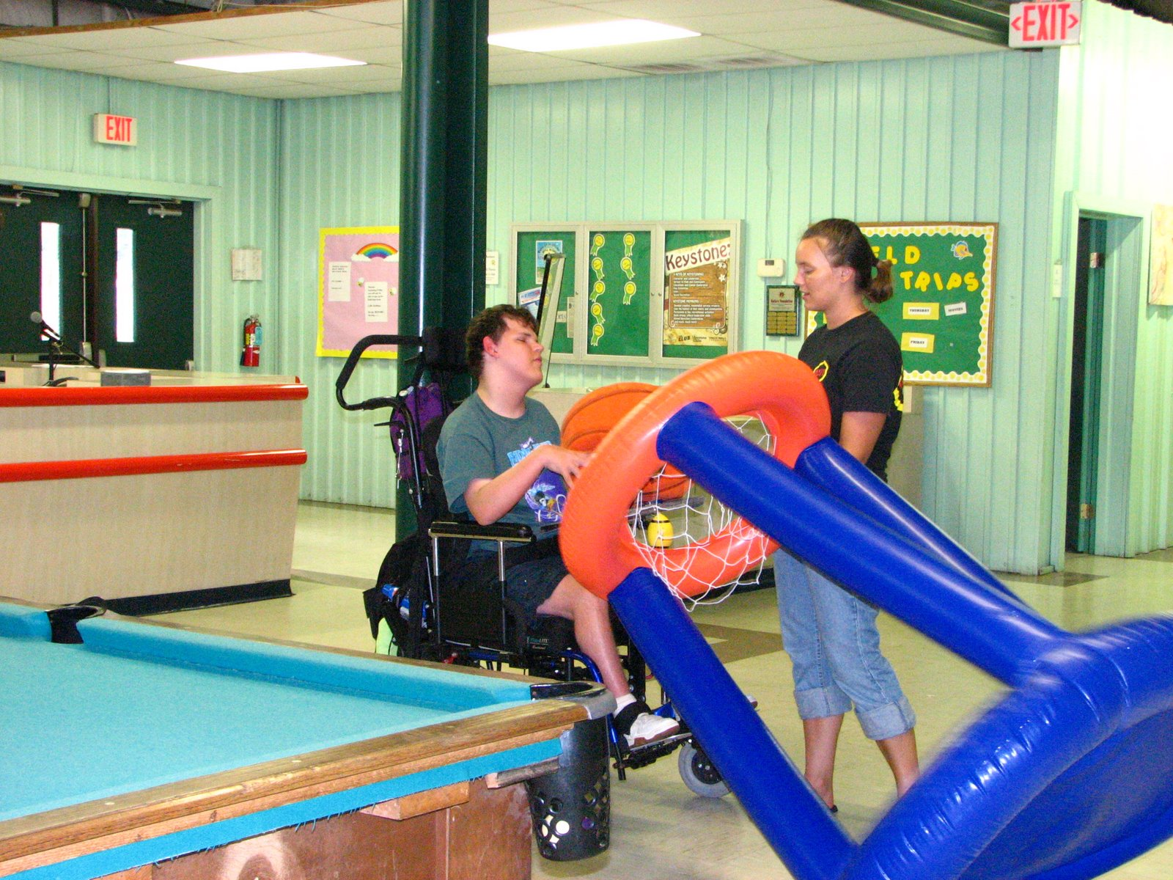

Slide 35
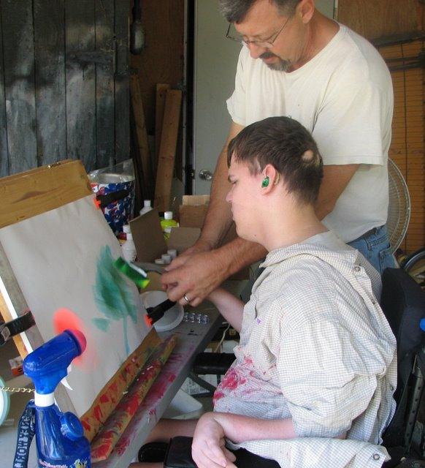
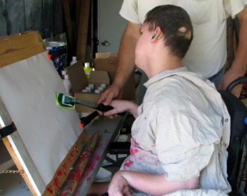
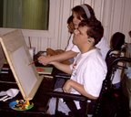
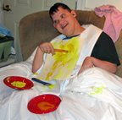
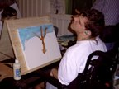

Slide 36
For almost twenty years, Noah woke up every day wanting to go out into the world and make new friends. He met a lot of people, and Noah made many friends. Noah liked nothing better than playing, any game or sport or activity, with friends.
For almost ten years, Noah loved playing baseball, soccer, basketball, kickball, bowling and swimming, with his Endeavor friends and buddies.
Every day of Noah's life, he inspired us to find new games he could play, new ways to play, new places to play, and new friends that he could play with. He continues to inspire us. So we keep looking for new games and ways and places to play.
In 2009, Endeavor Adapted & Inclusive Recreation was renamed "Noah's Endeavor."
We invite EVERYONE to come and play with us!
Noah wouldn't want anyone to be left out.
www.noahsendeavor.org

